Slide 1
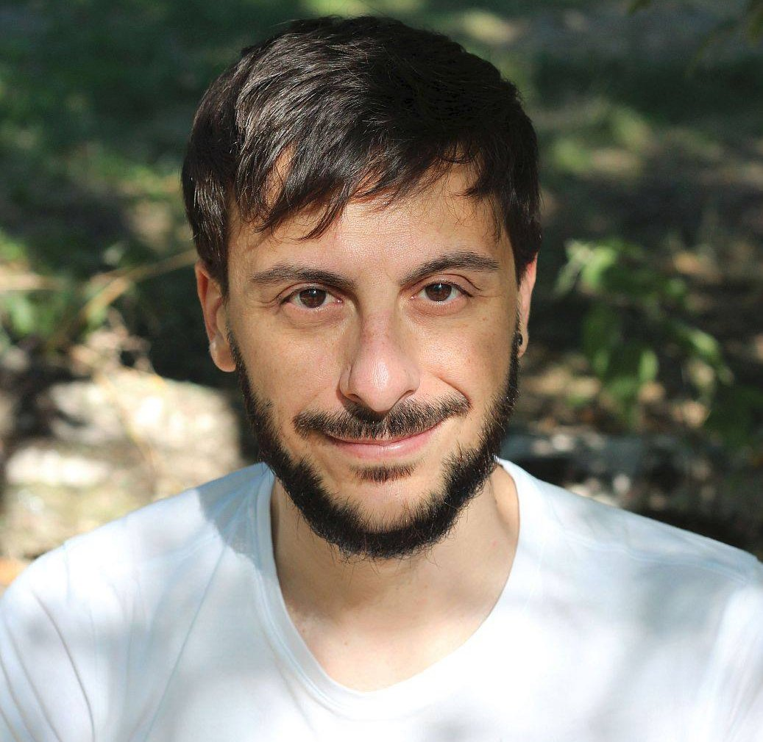
How to preregister
your research on the Open Science
Framework
Antonio Schettino, Ph.D.
Coordinator Open Science
Erasmus Research Services
schettino@eur.nl
slides: https://osf.io/ty3wh/
Notes:
‹#›

Slide 2
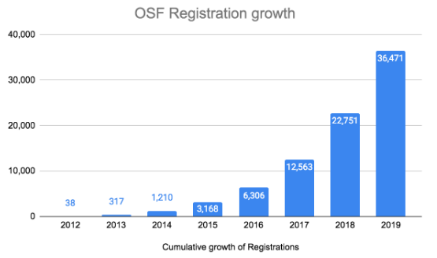
What Is Preregistration?
A document that:
specifies research design and analysis plan before the project starts
is uploaded on dedicated repositories
is made public, either immediately or after an embargo period
Ensuring the quality and specificity of preregistrations (Bakker et al., 2020)

Slide 3
Why Preregistration?
Transparent communication of information that can highlight:
Confirmation bias: prefer information that supports our beliefs
Motivated reasoning: post-hoc rationalizations that justify our decisions
Hindsight bias: “I knew it all along”
Apophenia: identify patterns in randomness
Researcher degrees of freedom: many ways to analyze and interpret data
Calibrate confidence on reported results and interpretations
Preregistration: A pragmatic tool to increase transparency, reduce bias, and calibrate confidence in scientific research (Hardwicke & Wagenmakers, 2021)

Slide 4
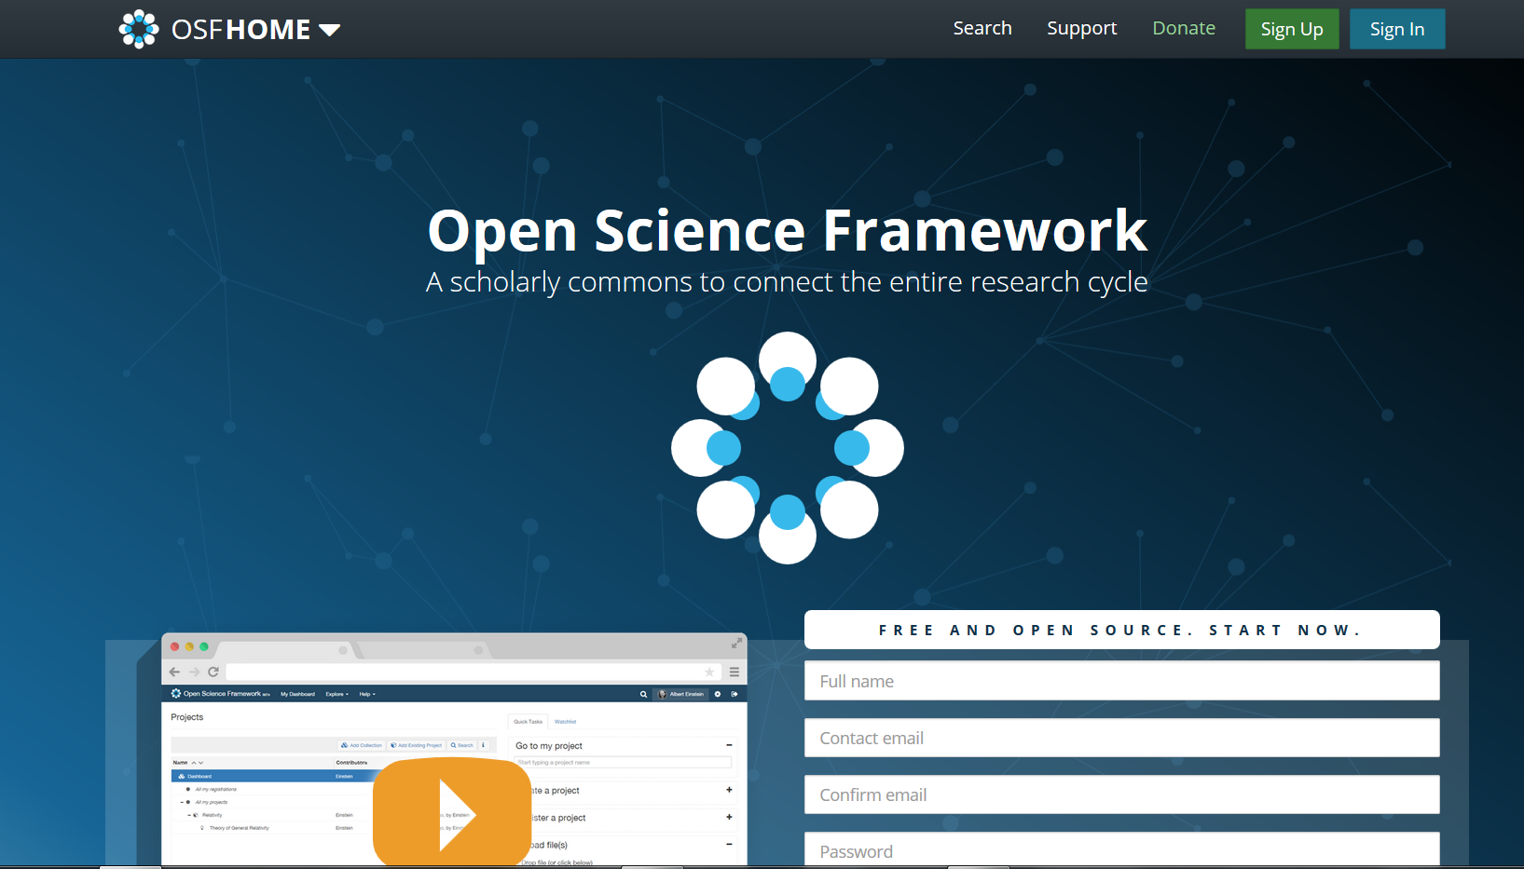
Open Science Framework
System to help researchers
manage
document
(optionally) share
research output & workflow
free
open source
discipline-agnostic
EGSH OSF hands-on tutorial
(next edition: April 12th 2022)
https://osf.io/

Slide 5
HANDS-ON SESSION

Slide 6
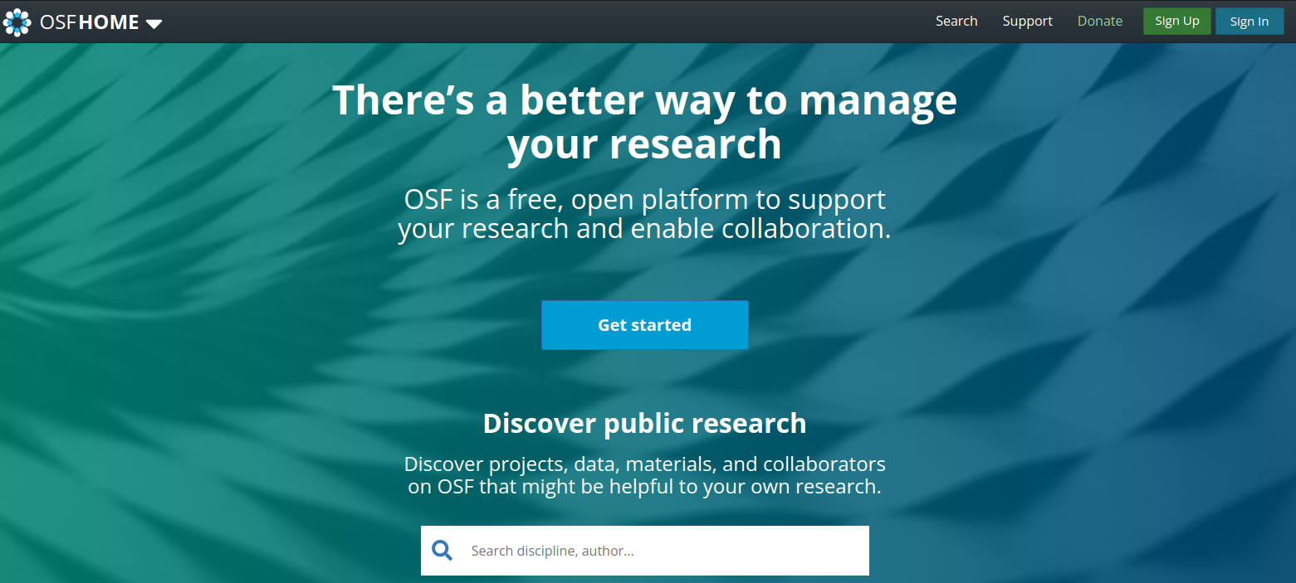
Log In
https://osf.io/

Slide 7
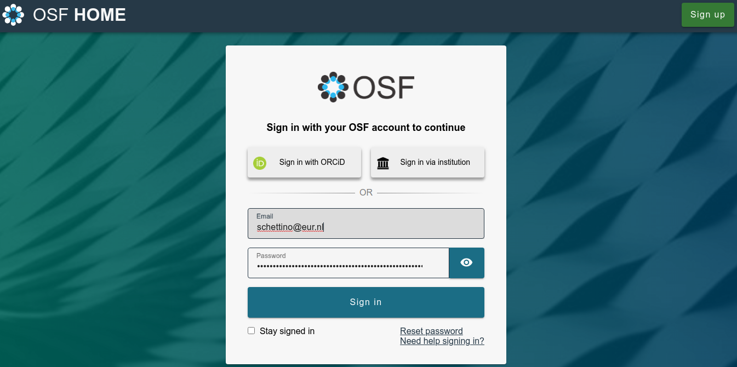
Log In
work in progress…
https://orcid.org/

Slide 8
OSF Dashboard

Slide 9
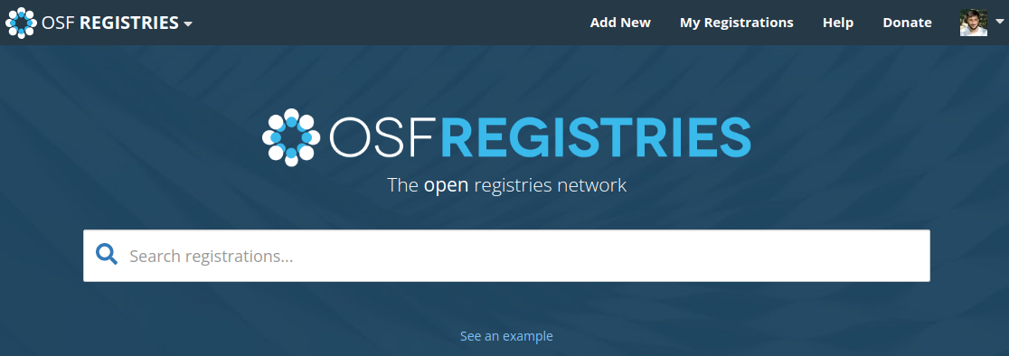
OSF Registries

Slide 10
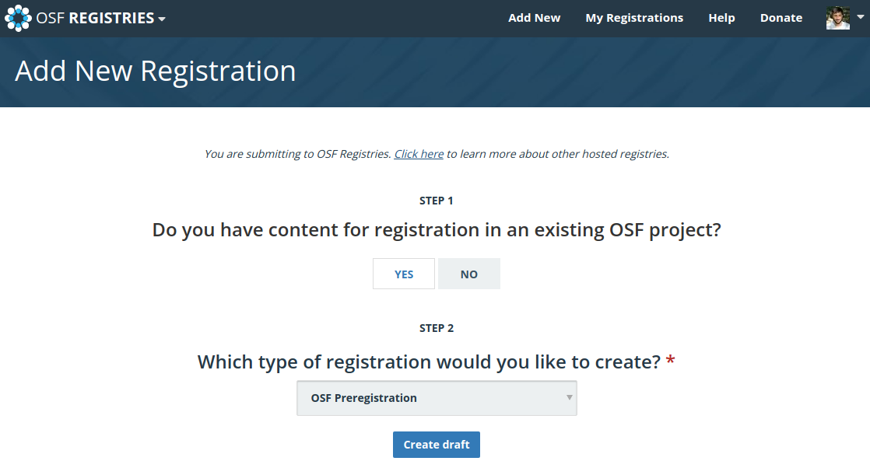
Create First Draft

Slide 11
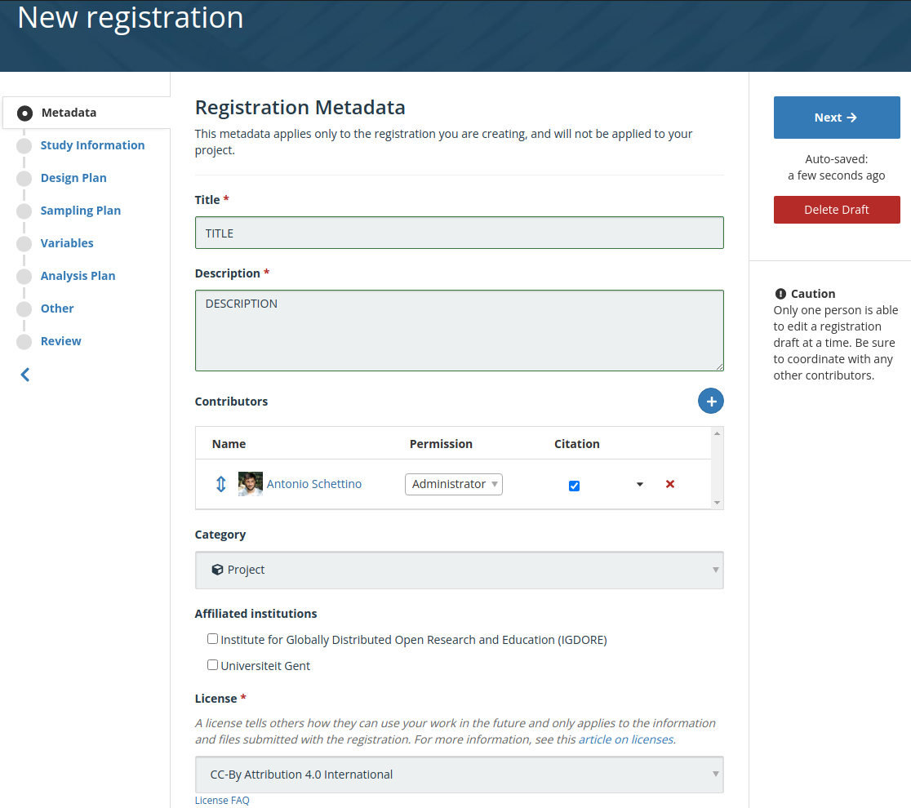
Metadata
add collaborators
soon you might see EUR…

Slide 12
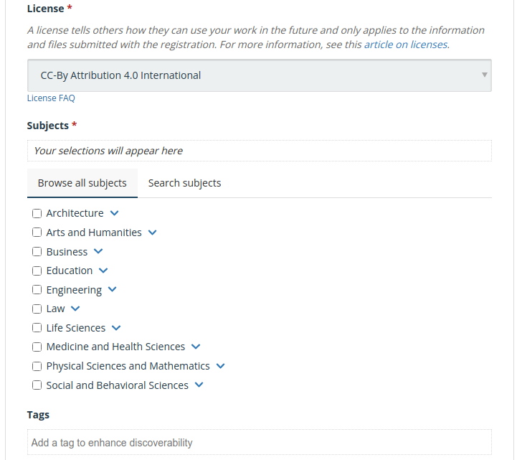
Metadata (cont.)
see also https://choosealicense.com

Slide 13
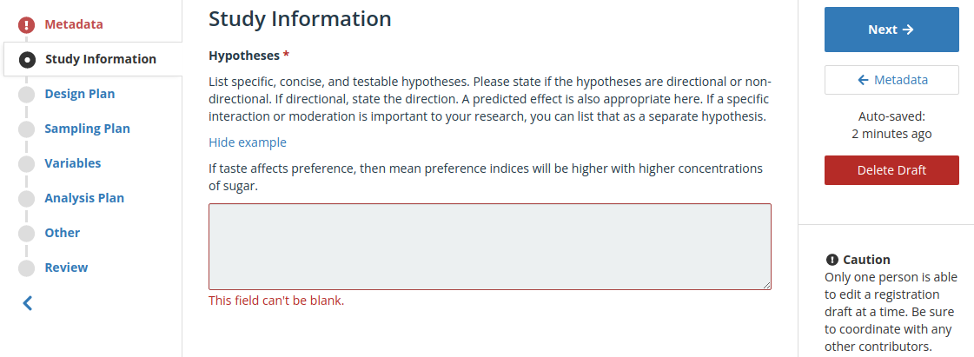
Study Information

Slide 14
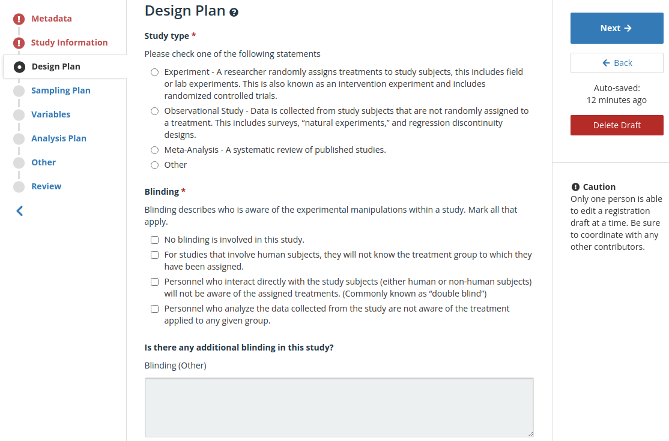
Design Plan

Slide 15
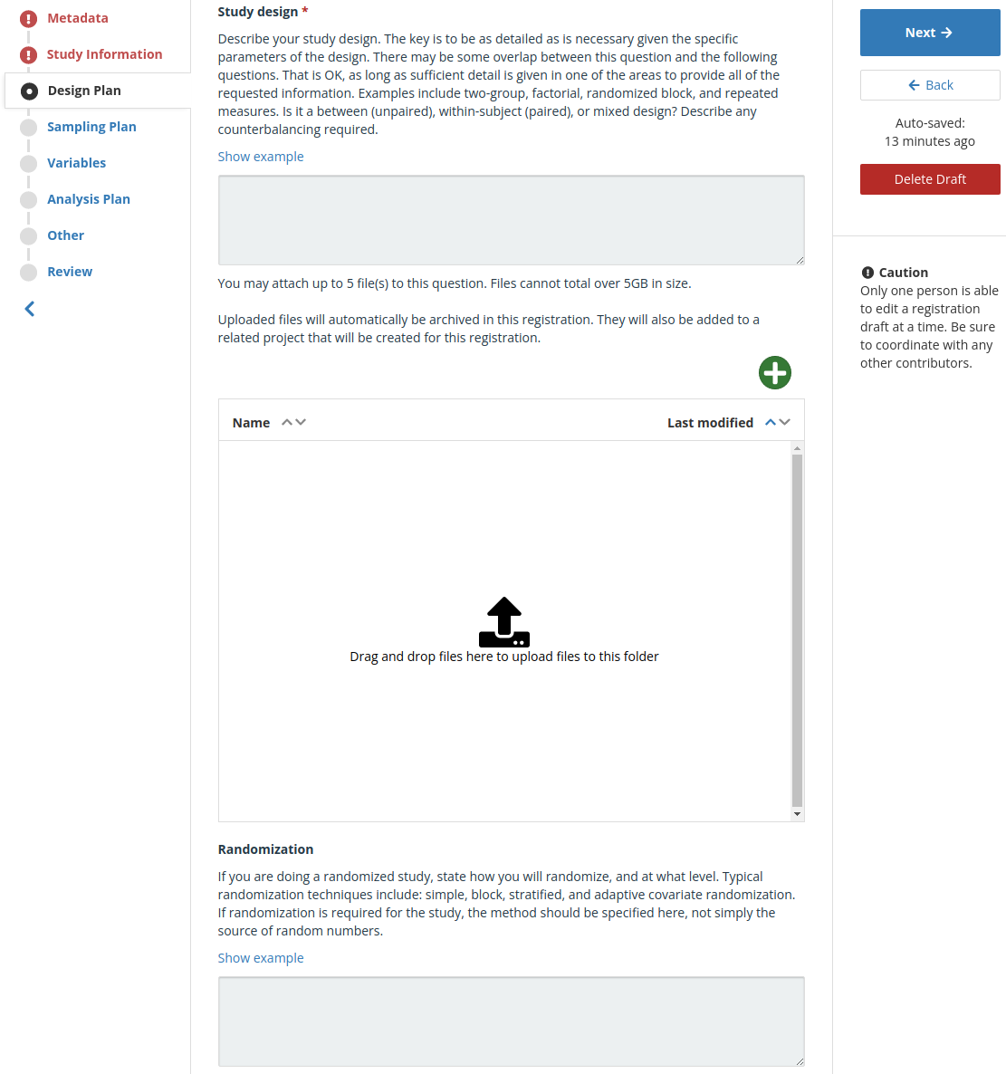
Design Plan (cont.)
possibility to upload
additional materials
(e.g., scripts, interview protocols, questionnaires, …)

Slide 16
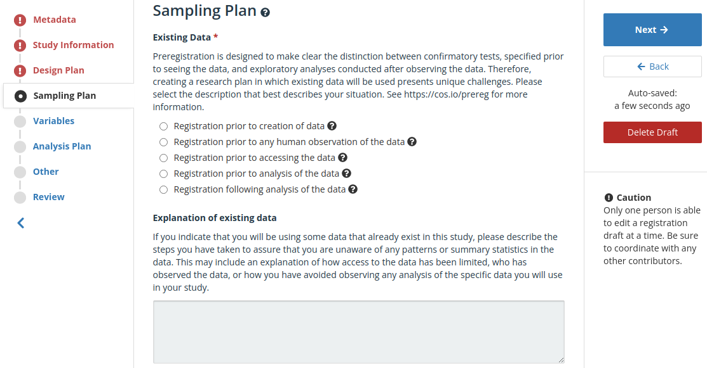
Sampling Plan
better use preregistration template for secondary analysis
not recommended

Slide 17
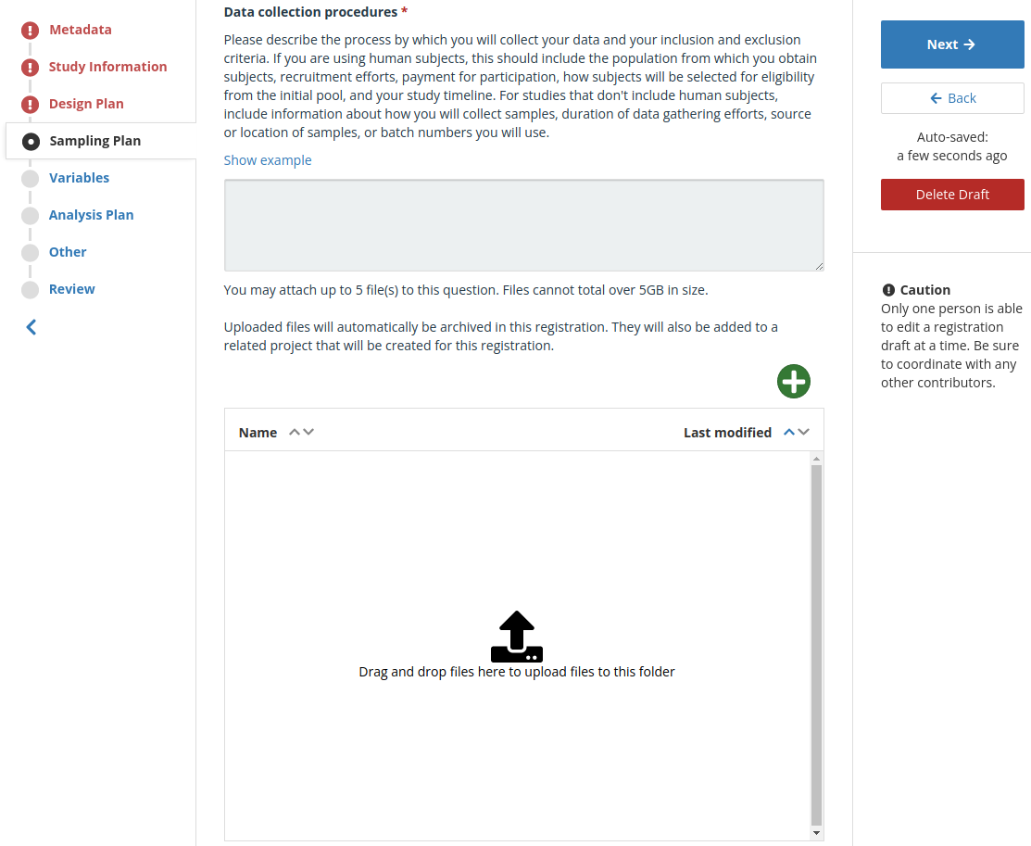
Sampling Plan (cont.)
possibility to upload
additional materials

Slide 18
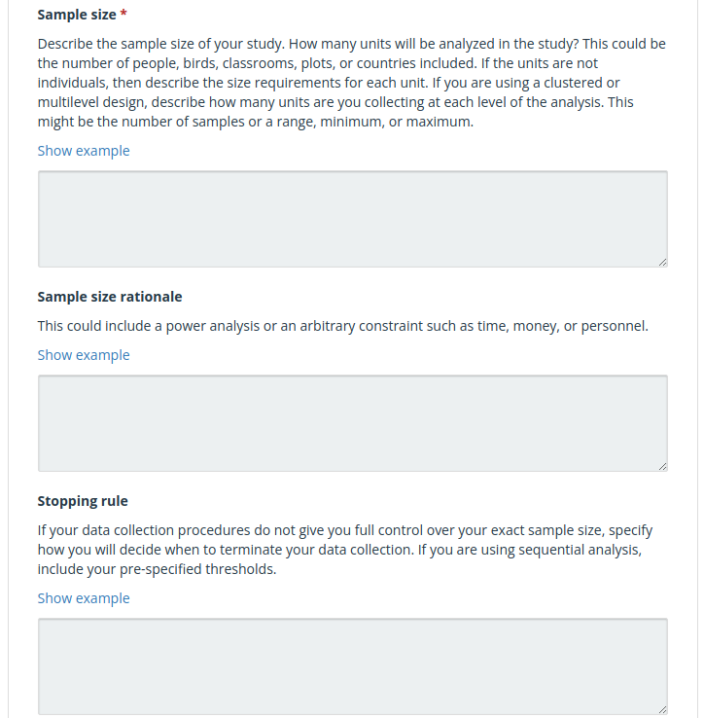
Sampling Plan (cont.)
while not all justifications have equal value,
the most important thing is transparency

Slide 19
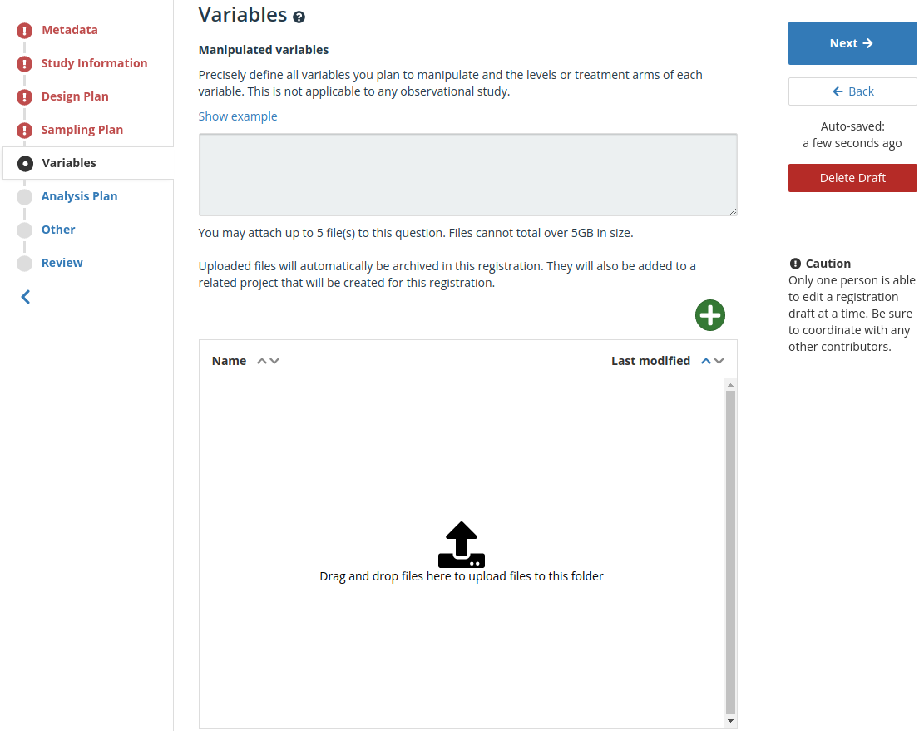
Variables
not compulsory but, if planned, consider adding

Slide 20
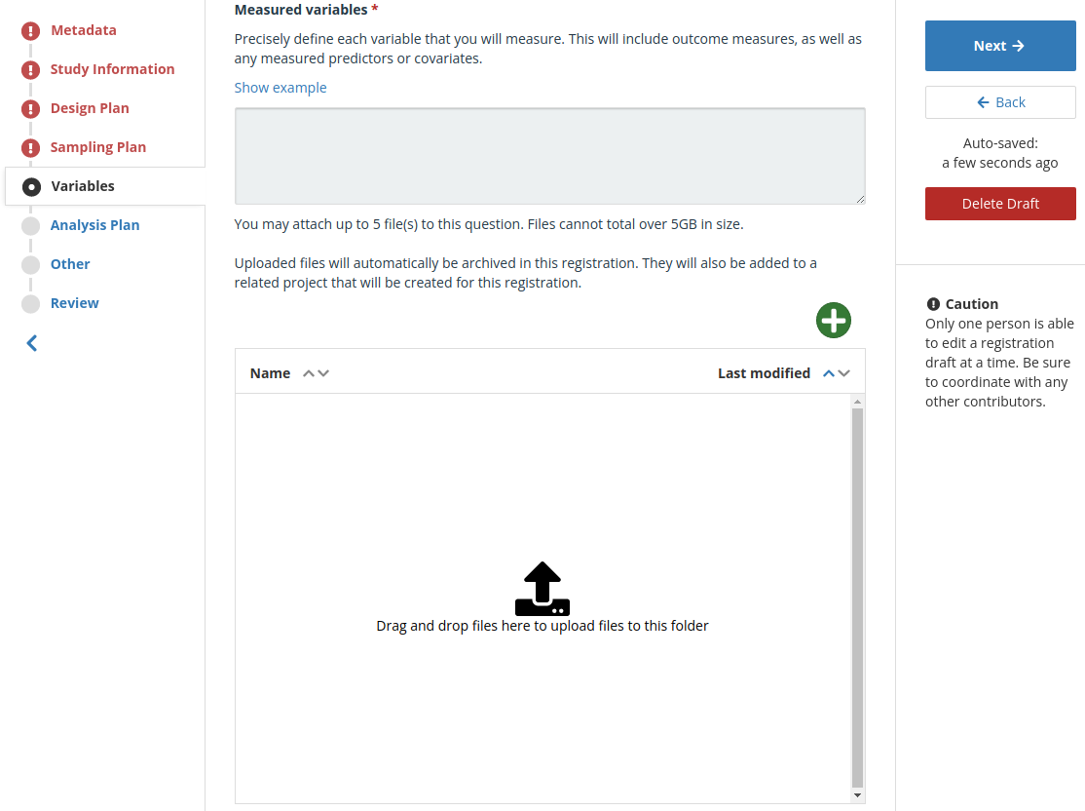
Variables (cont.)
are all variables linked to testable hypotheses?

Slide 21
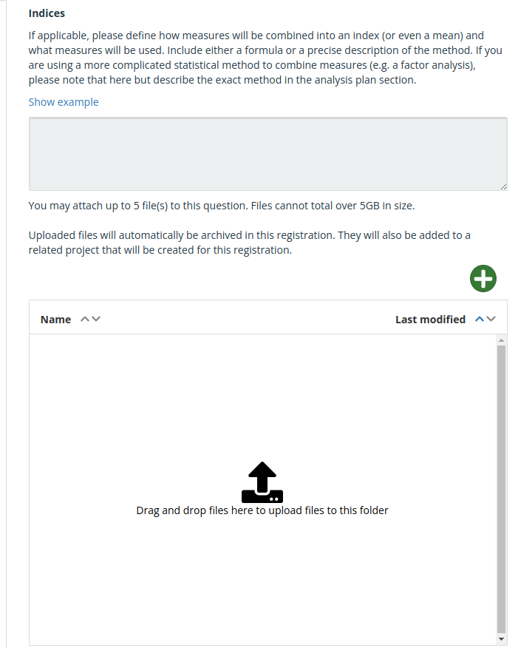
Variables (cont.)
possibility to upload
additional materials
(e.g., code for transformations)

Slide 22
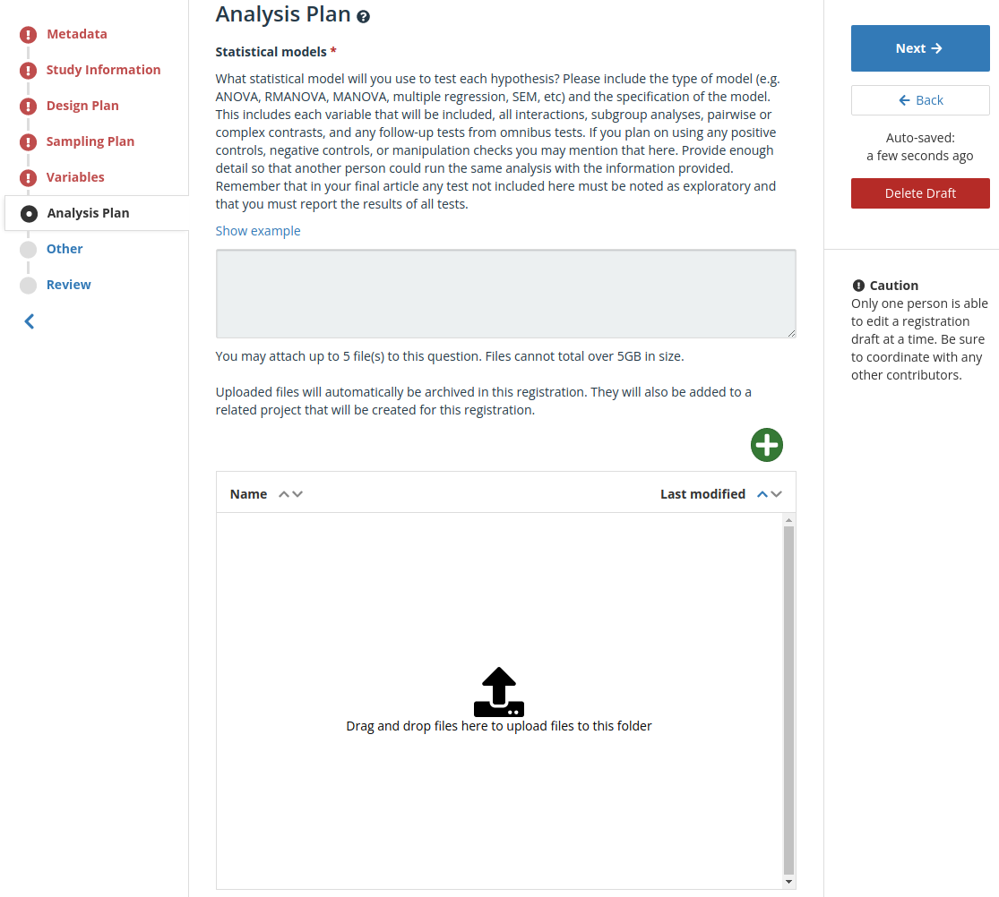
Analysis Plan
possibility to upload
additional materials
(e.g., analysis scripts tested on simulated or pilot data)

Slide 23
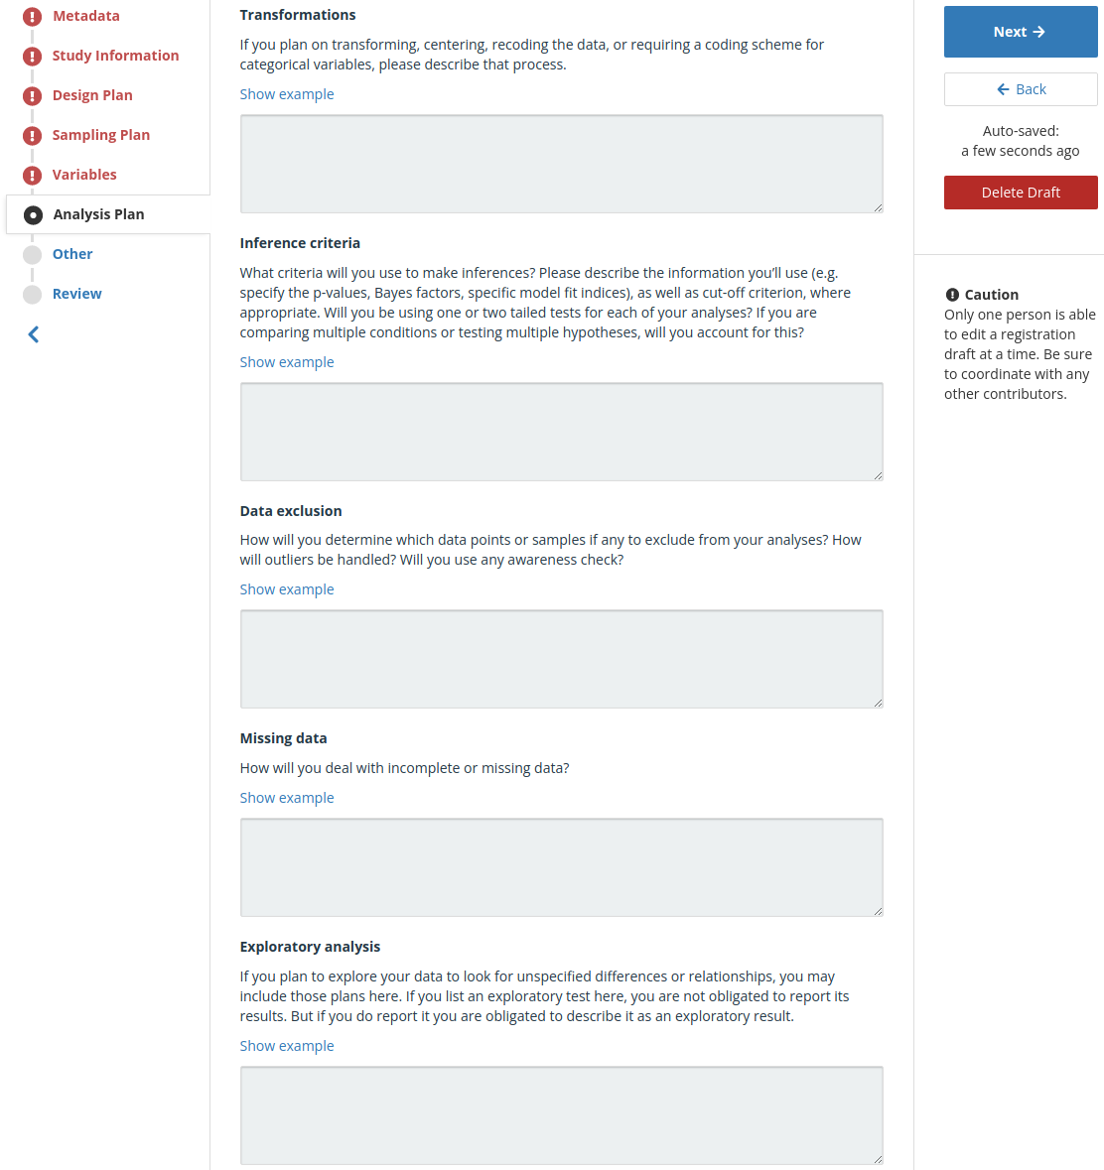
Analysis Plan (cont.)
if you already plan to explore some variables, perhaps you assume effects… so why not have testable hypotheses?

Slide 24
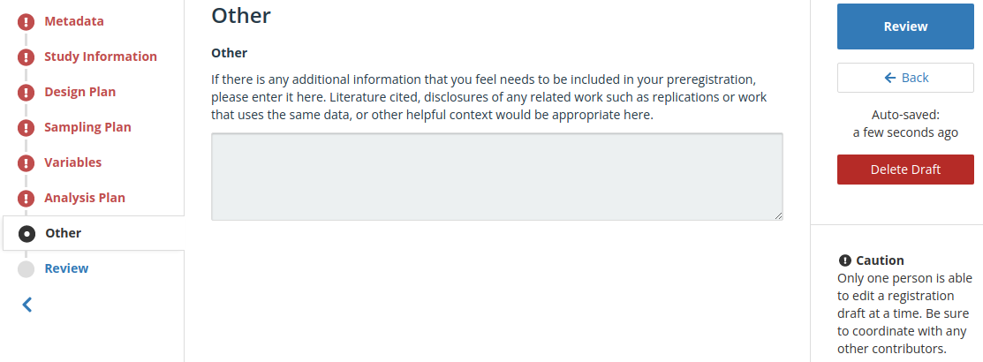
Other
often used for bibliography

Slide 25
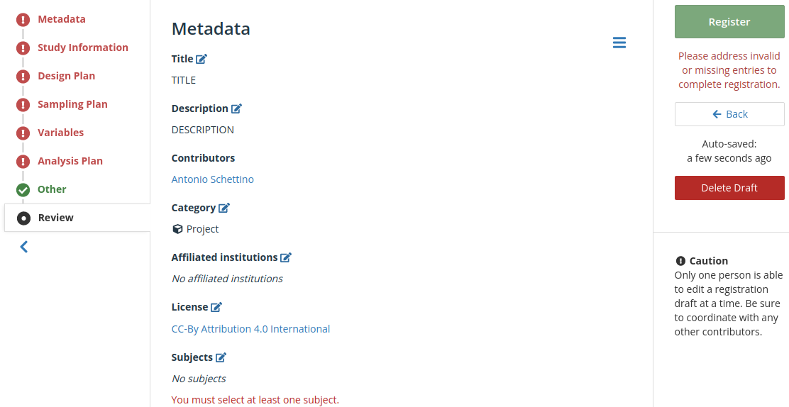
Review

Slide 26
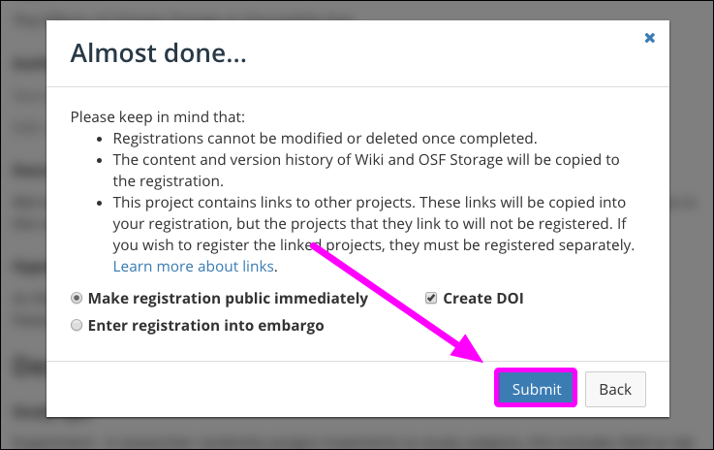
Register
Contributors have 48 hours to approve/cancel the submission
Preregistration is published
(either immediately or embargoed) if:
all admin contributors have approved the submission
OR
48 hours have passed
https://help.osf.io/hc/en-us/articles/1500005374982-Submit-Your-Draft-Registration

Slide 27
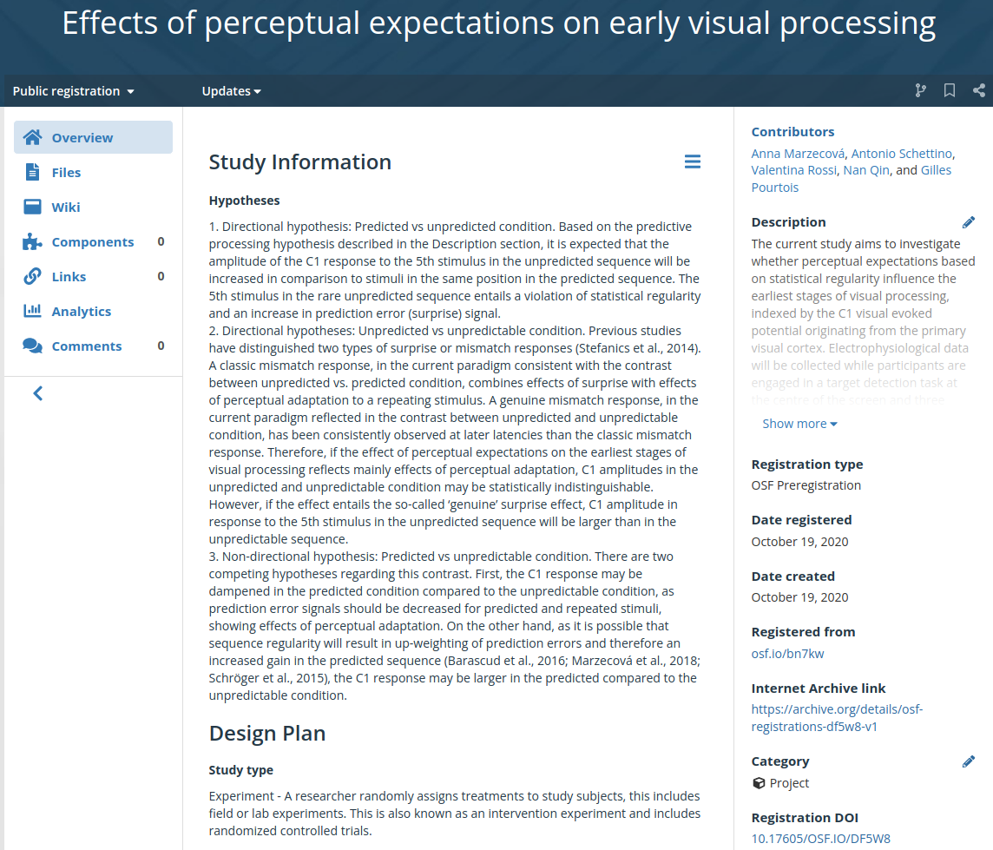
Example 1: OSF Prereg Template
https://doi.org/10.17605/OSF.IO/DF5W8

Slide 28
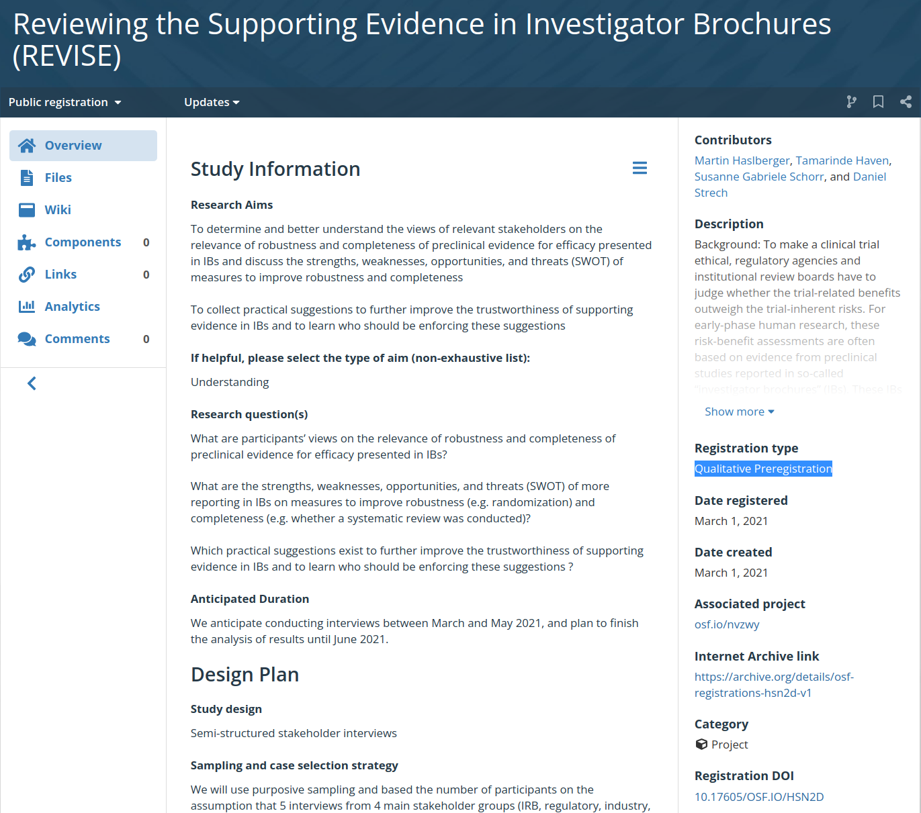
Example 2: Qualitative Prereg Template
https://doi.org/10.17605/OSF.IO/HSN2D

Slide 29
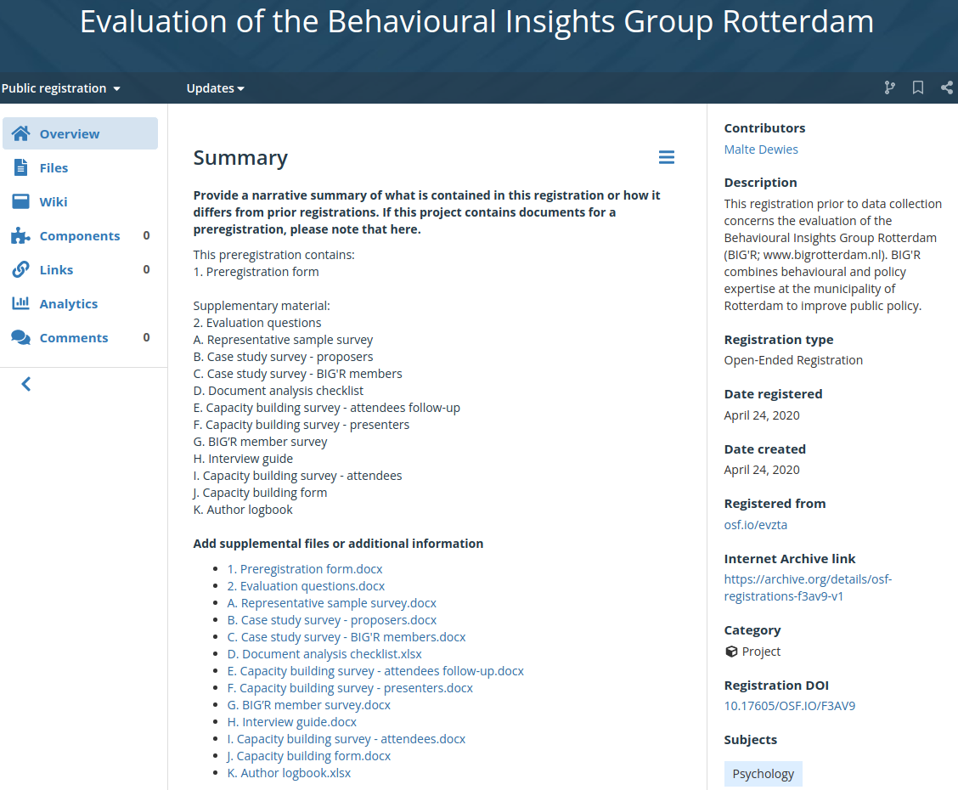
Example 2: Open-Ended Prereg Template
https://doi.org/10.17605/OSF.IO/F3AV9

Slide 30
Additional Information
Update a preregistration
Create view-only (anonymized) link to a preregistration
End an embargo earlier than planned
Withdraw a preregistration

Slide 31
Useful Resources
Literature
Preregistration: A pragmatic tool to increase transparency, reduce bias, and calibrate confidence in scientific research (Hardwicke & Wagenmakers, 2021)
What should a preregistration contain? (McPhetres, 2020)
Templates
Preregistration Templates
Checklist for comprehensive report of results
Transparent Changes Template Document
OSF
OSF Guides on registration
YouTube tutorials

Slide 32
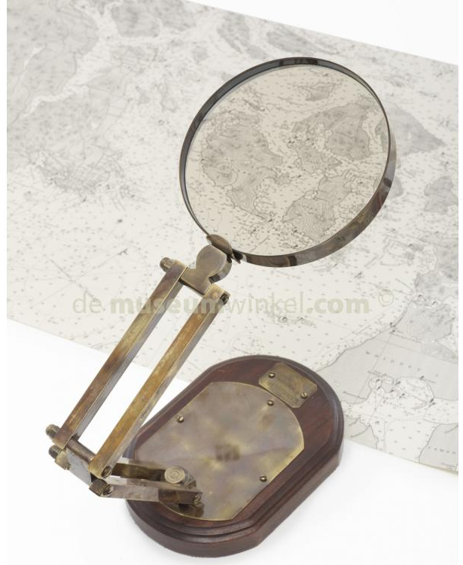
RAFFLE!
send us your OSF preregistration!
create a new one following what you learned today
use a preregistration you already created on the OSF
the preregistration can be public or embargoed
if public: link to DOI
if embargoed: view-only (anonymized) link
if you have several preregistrations, send only one
send to info@openscience-rotterdam.com
chance to win a supercool magnifying glass!

Slide 33
HAPPY PREREGISTRATION!

