Slide 1
References to Trump

Slide 2
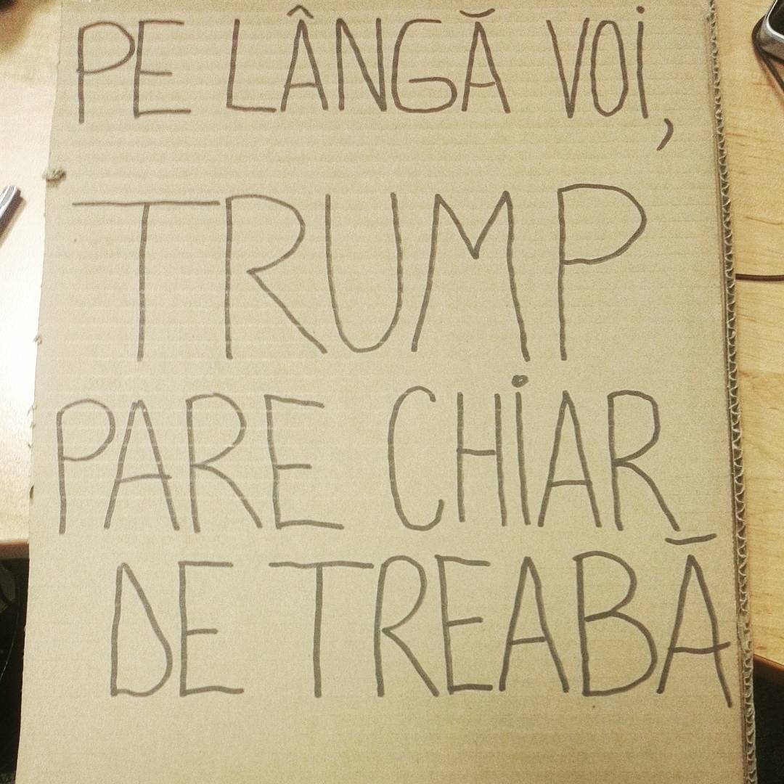

Slide 3
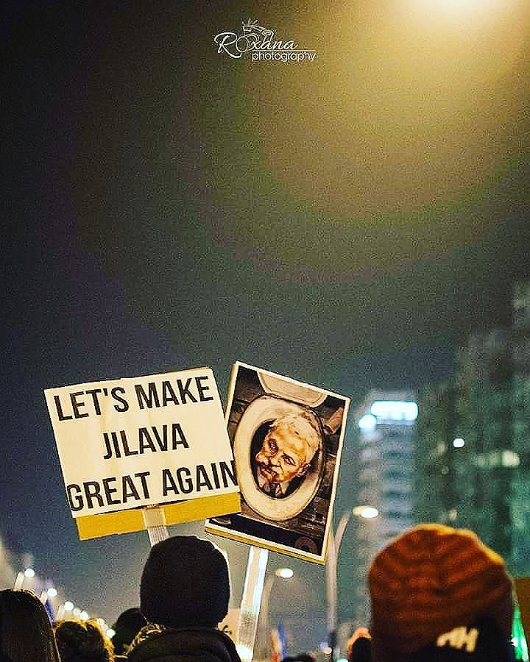
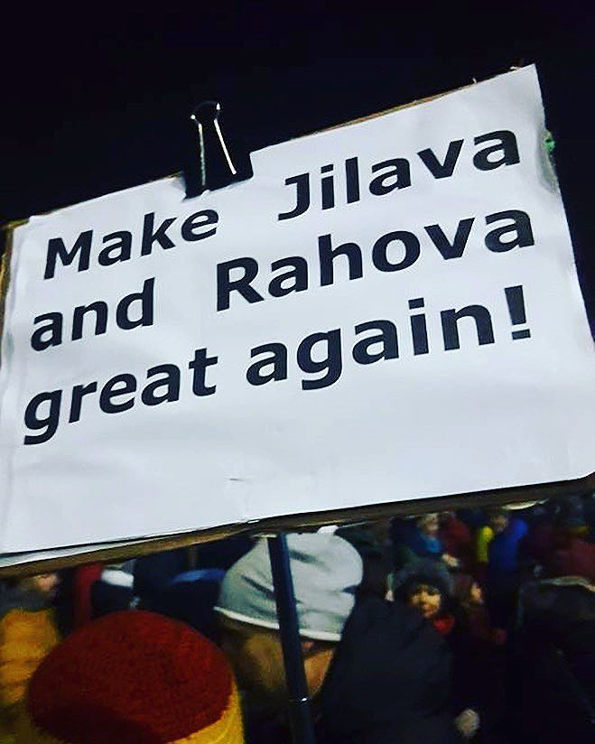

Slide 4
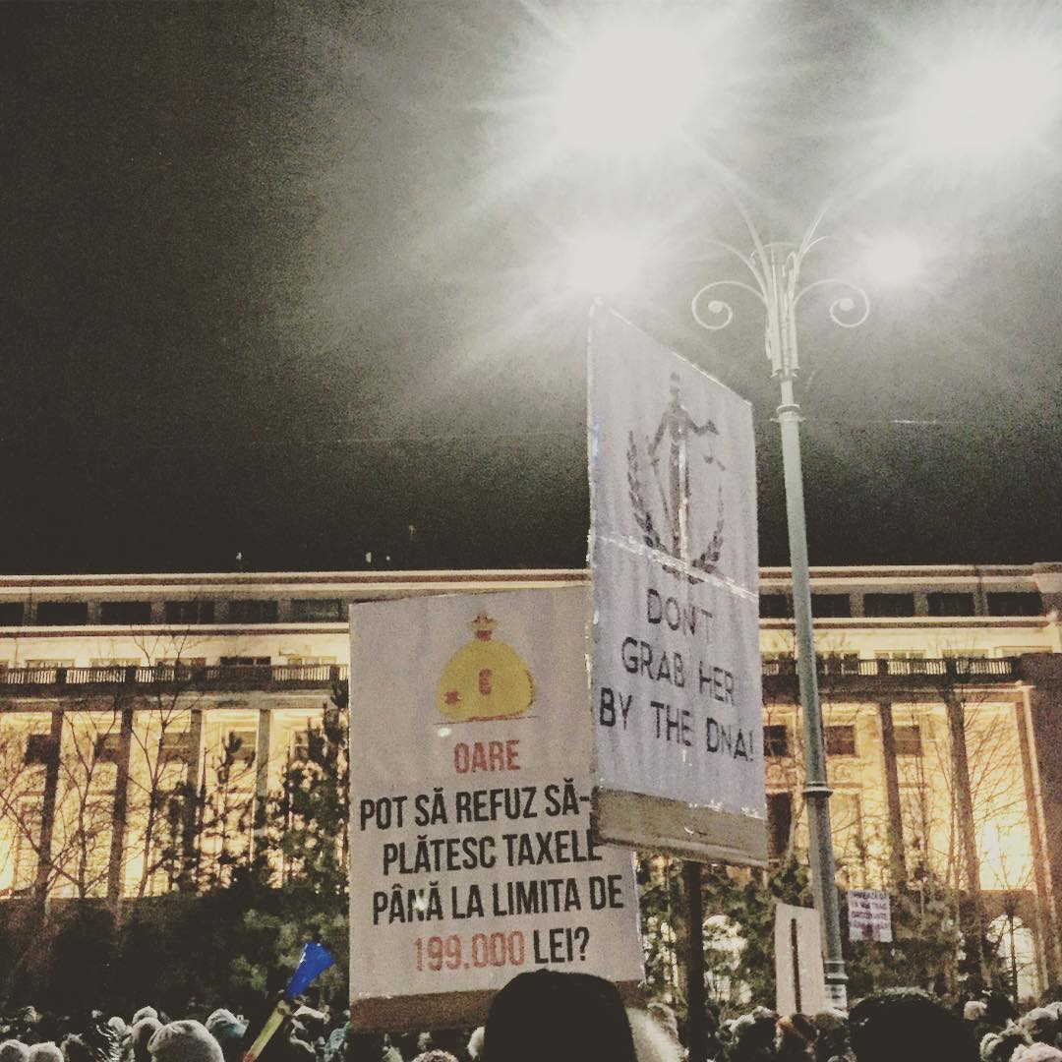

Slide 5
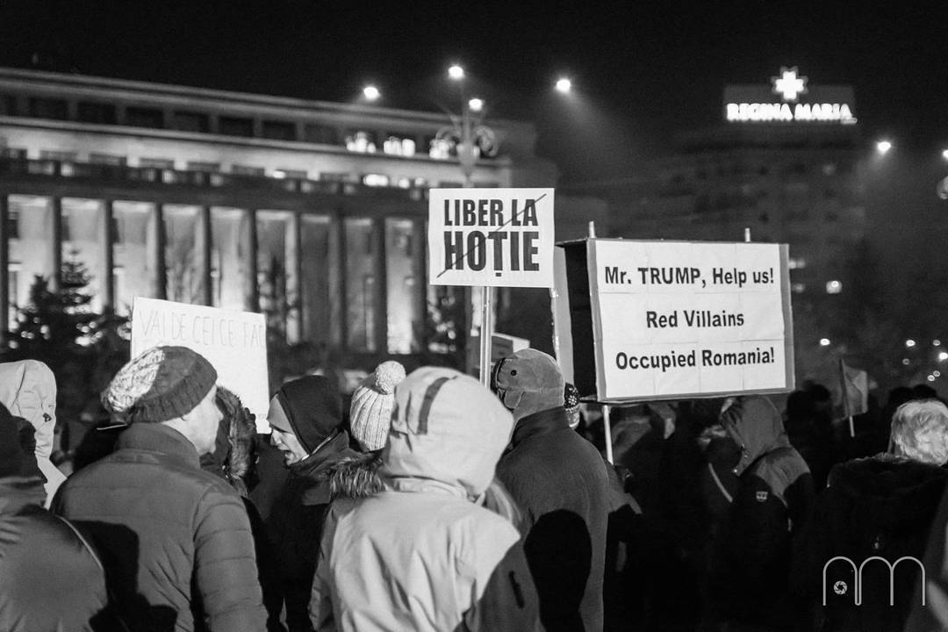

Slide 6
References to other political leaders/ contexts

Slide 7
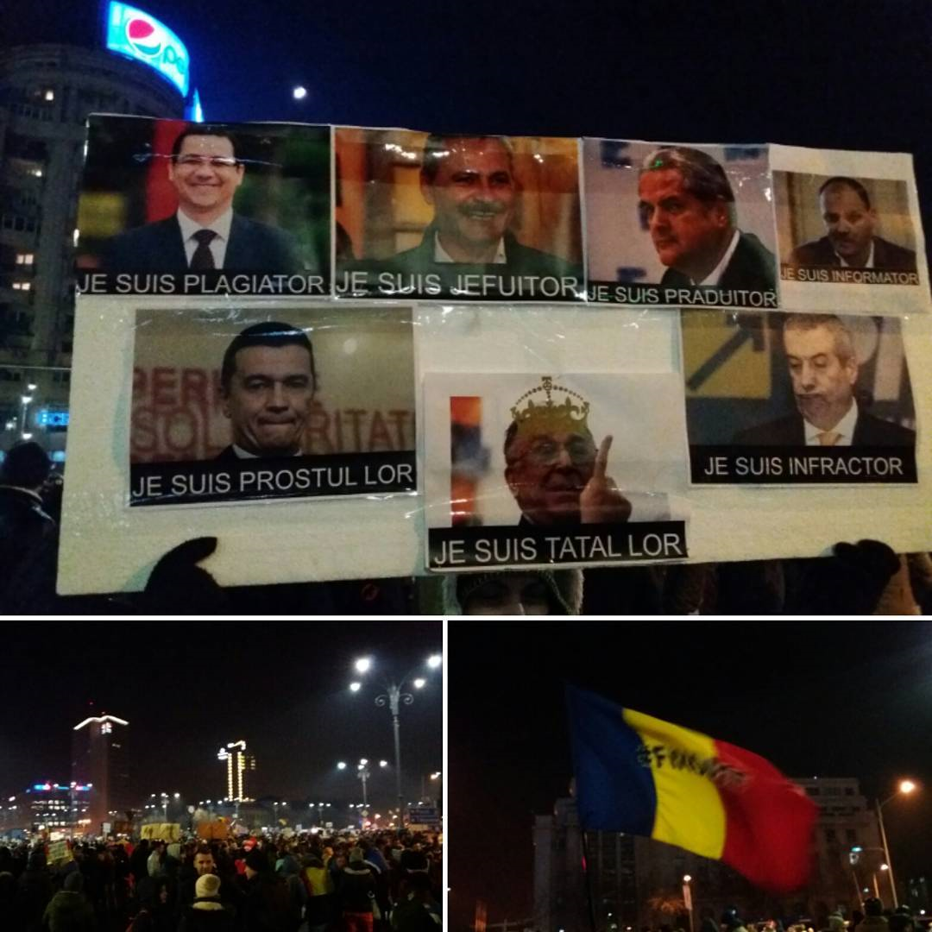
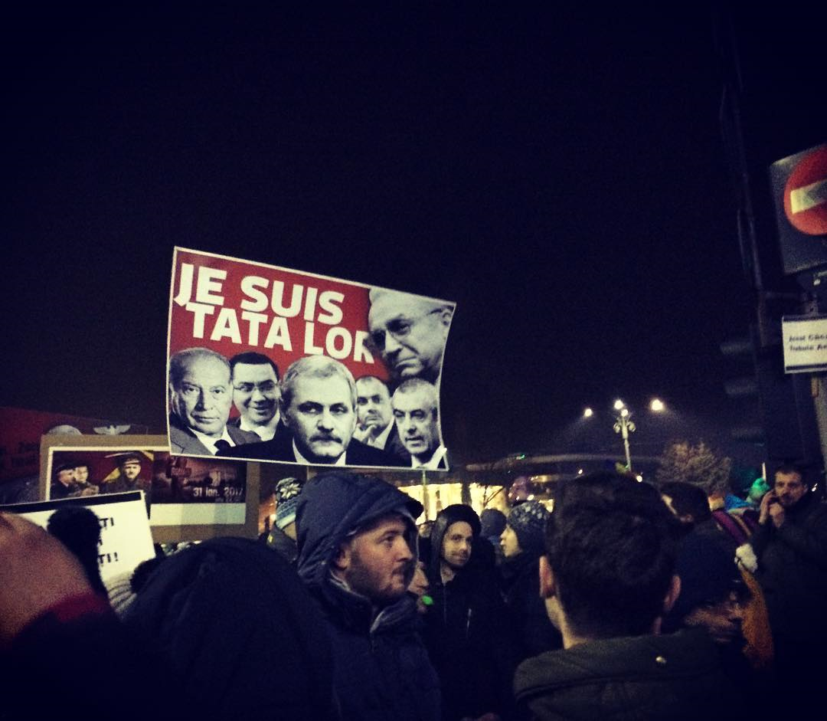

Slide 8
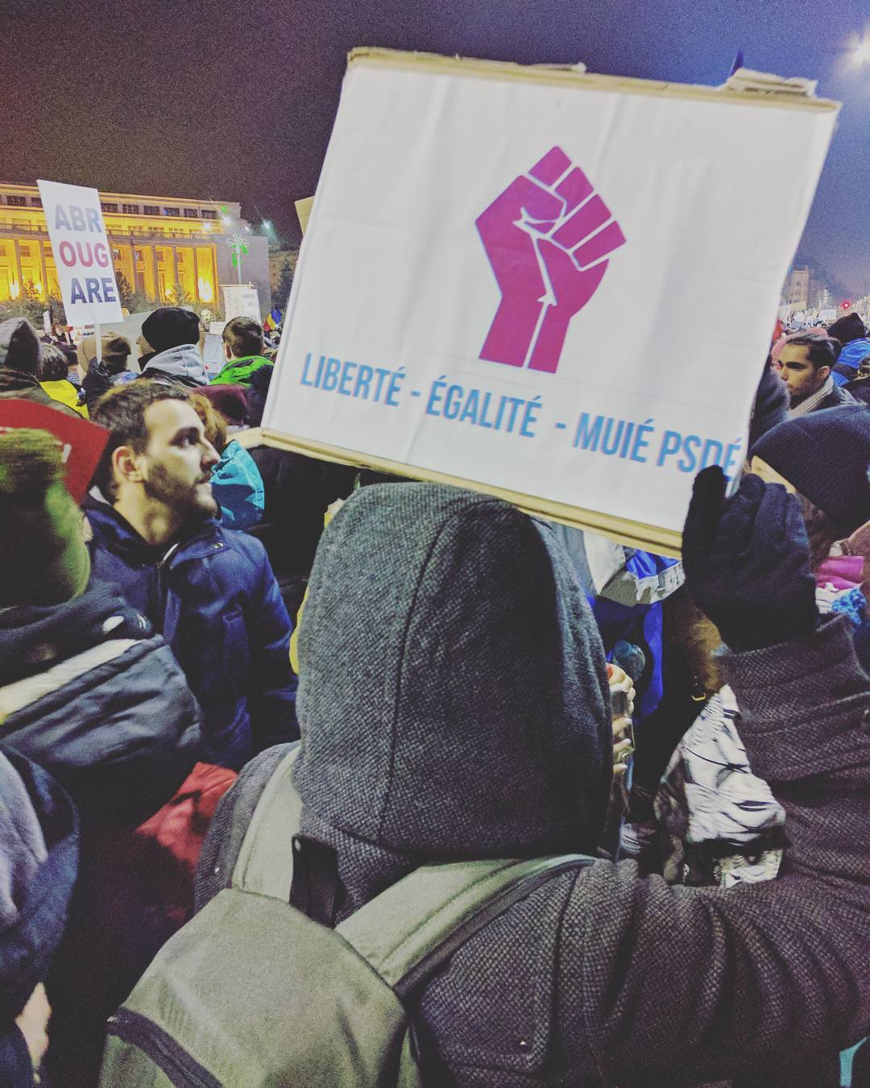
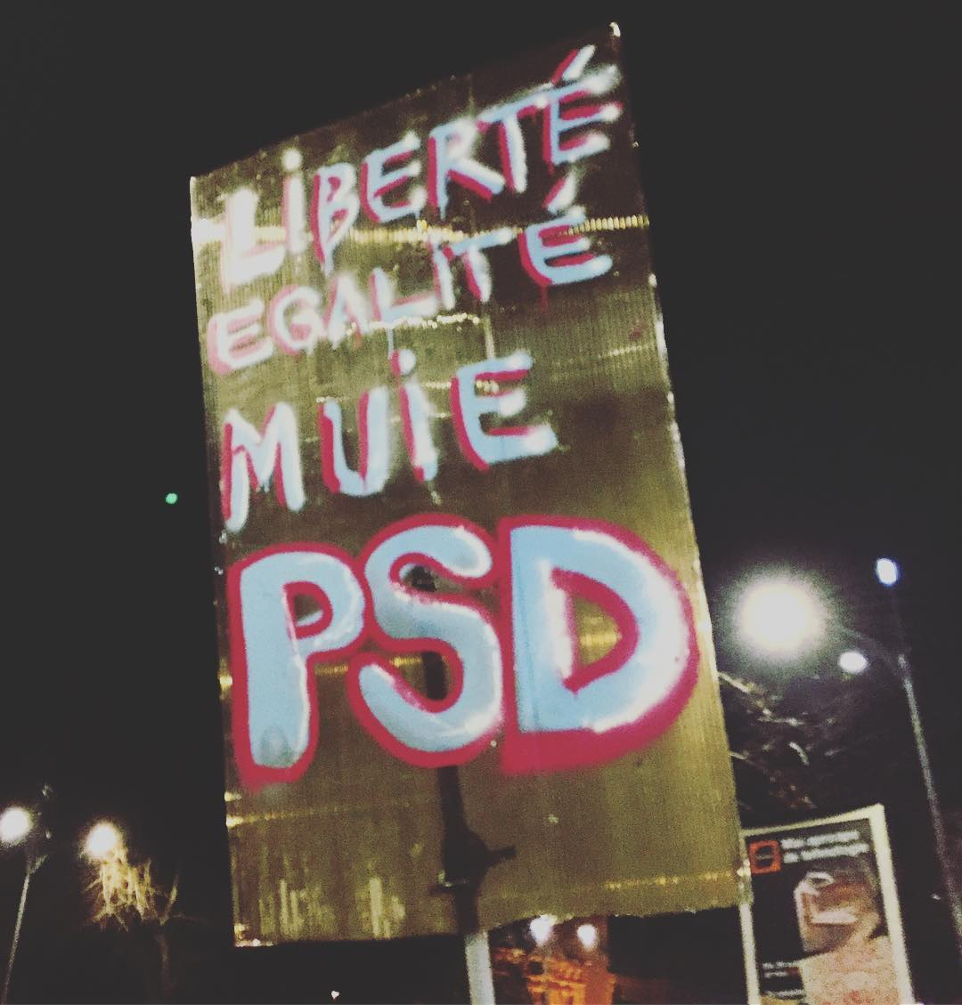
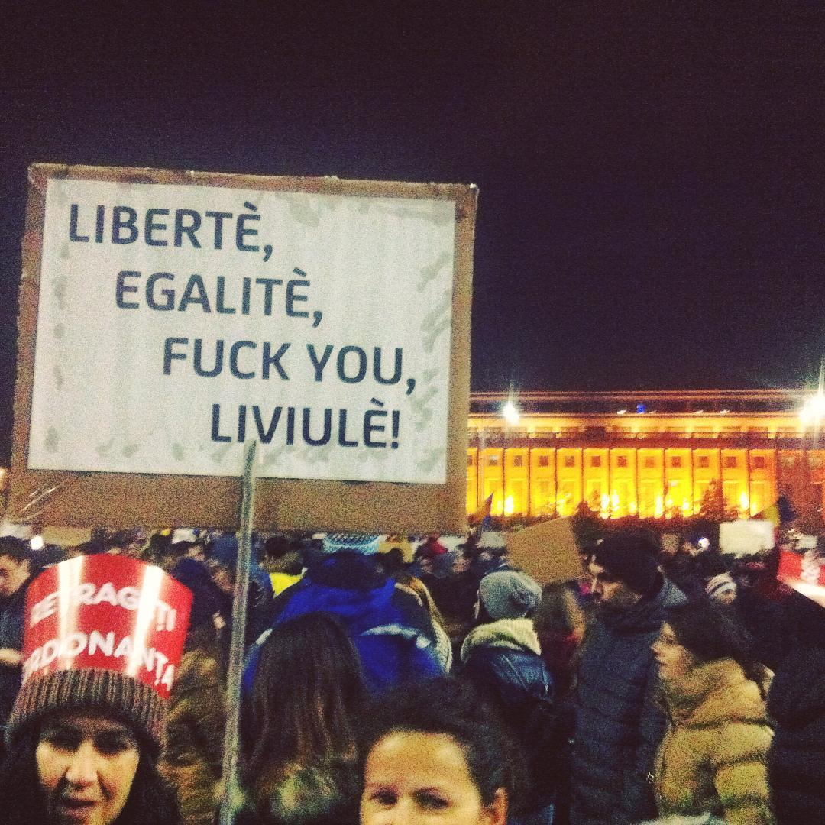

Slide 9
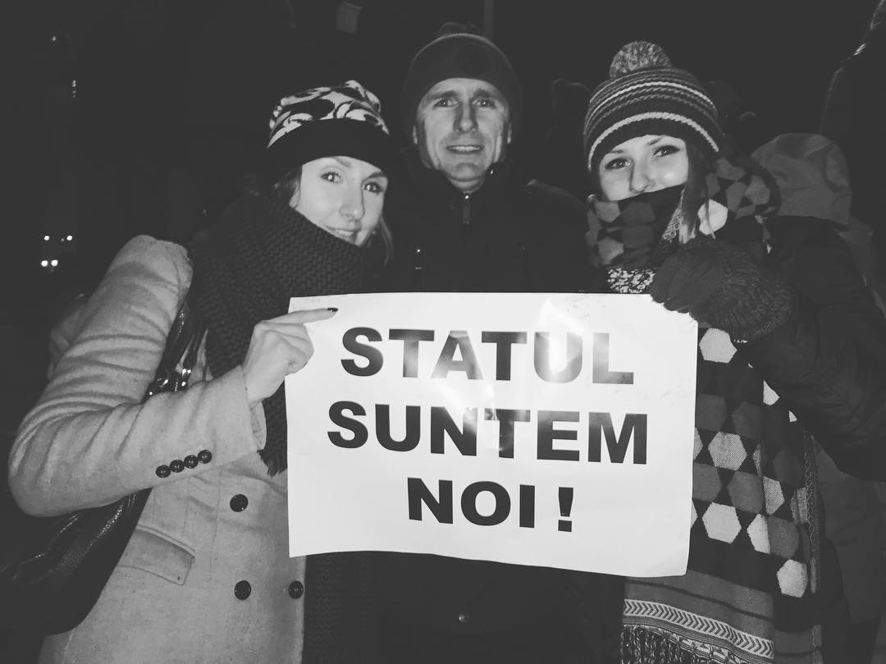

Slide 10
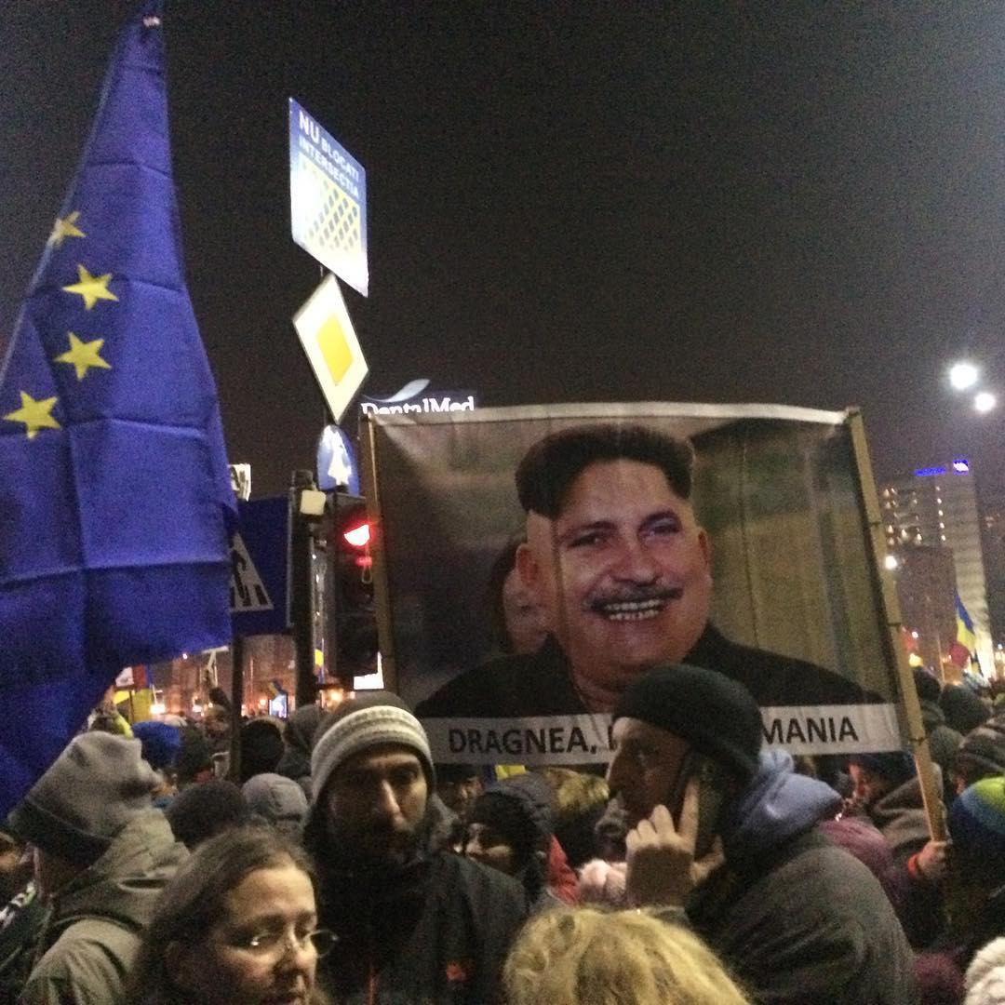

Slide 11
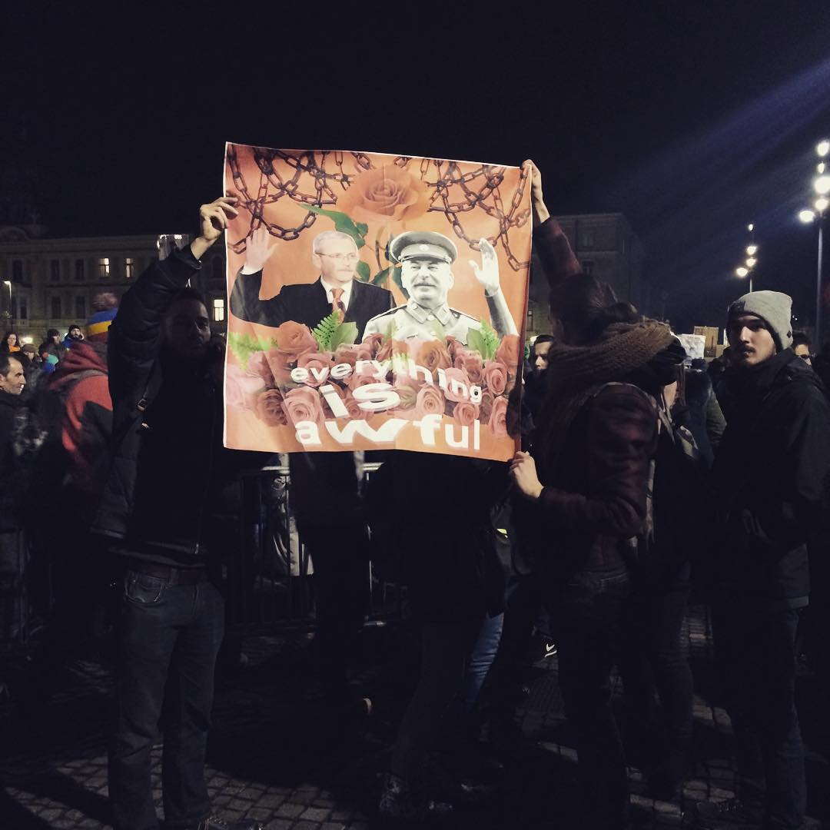

Slide 12
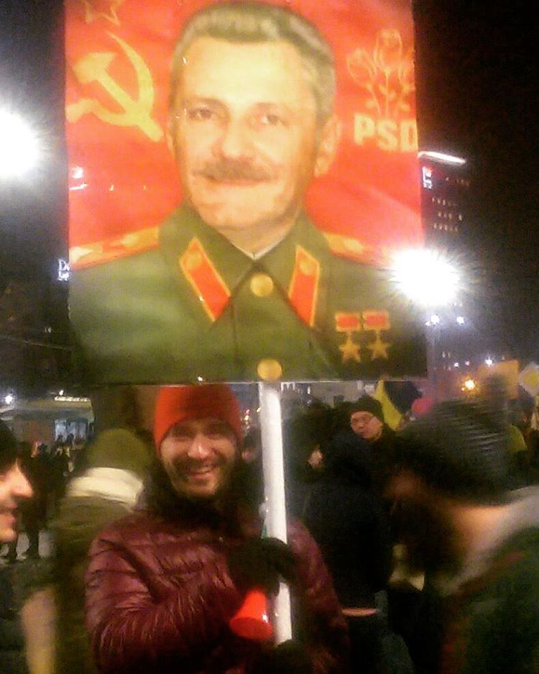

Slide 13
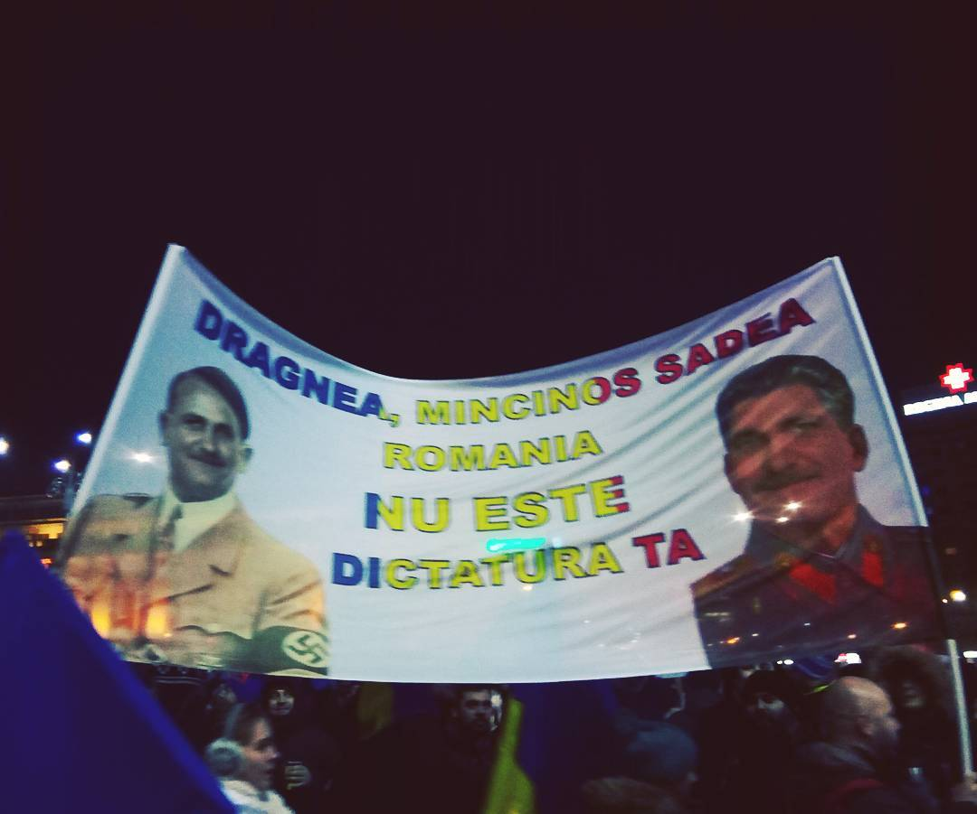

Slide 14
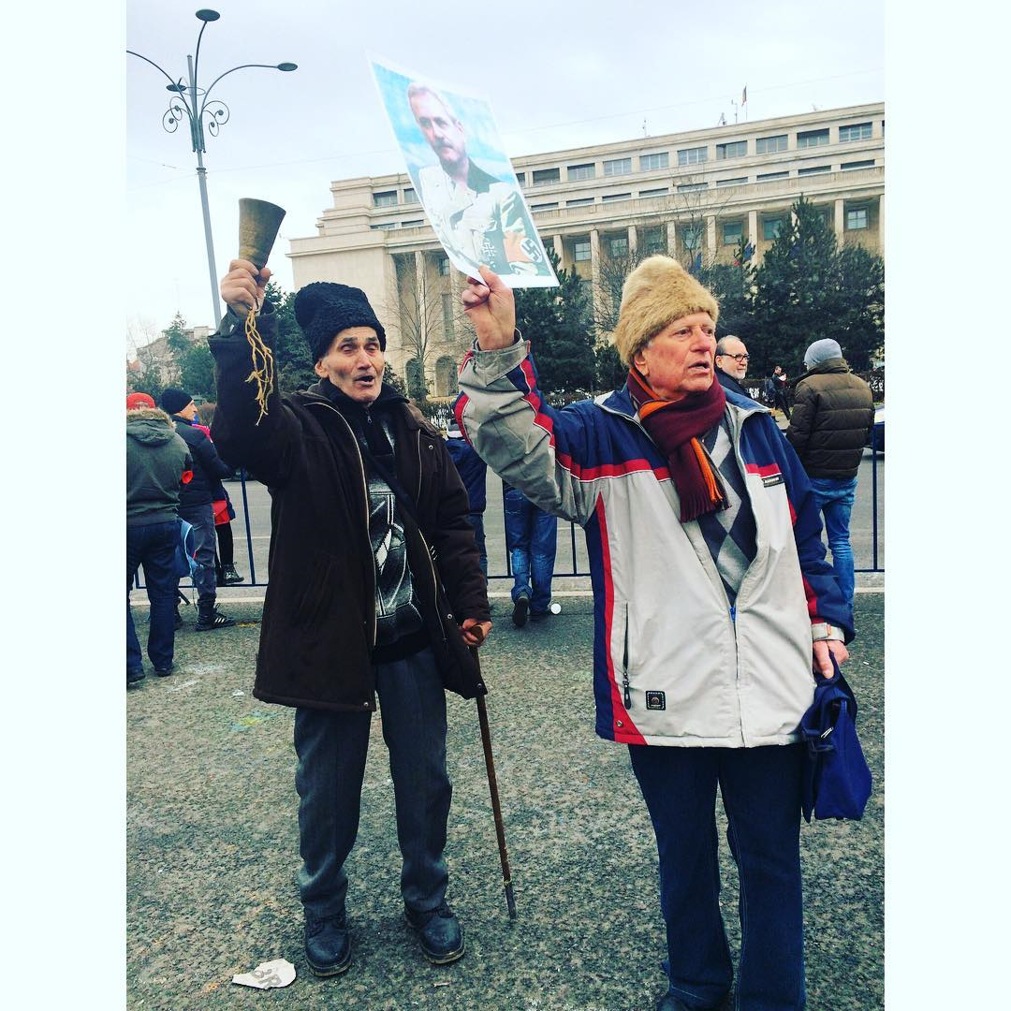

Slide 15
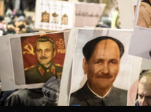

Slide 16
References to computers/ games

Slide 17
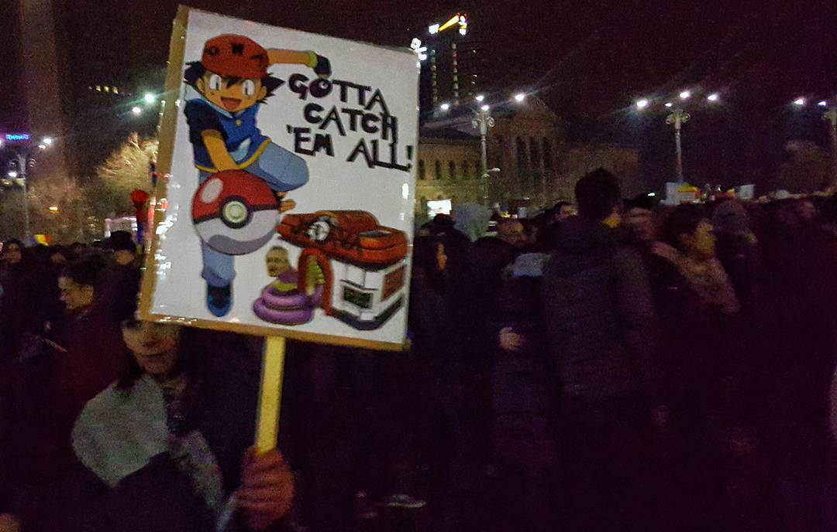

Slide 18
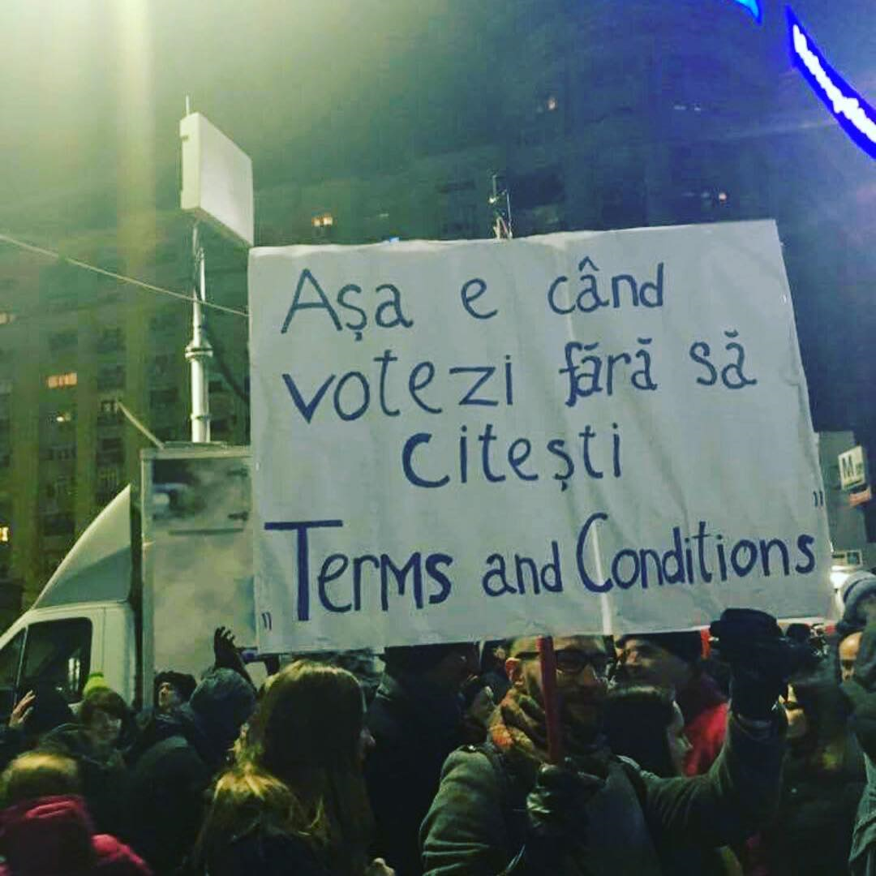

Slide 19
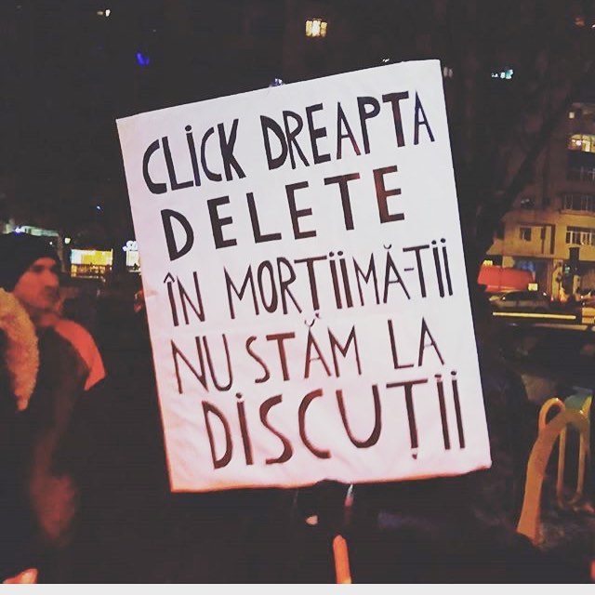
Taken Feb. 13, 2017

Slide 20
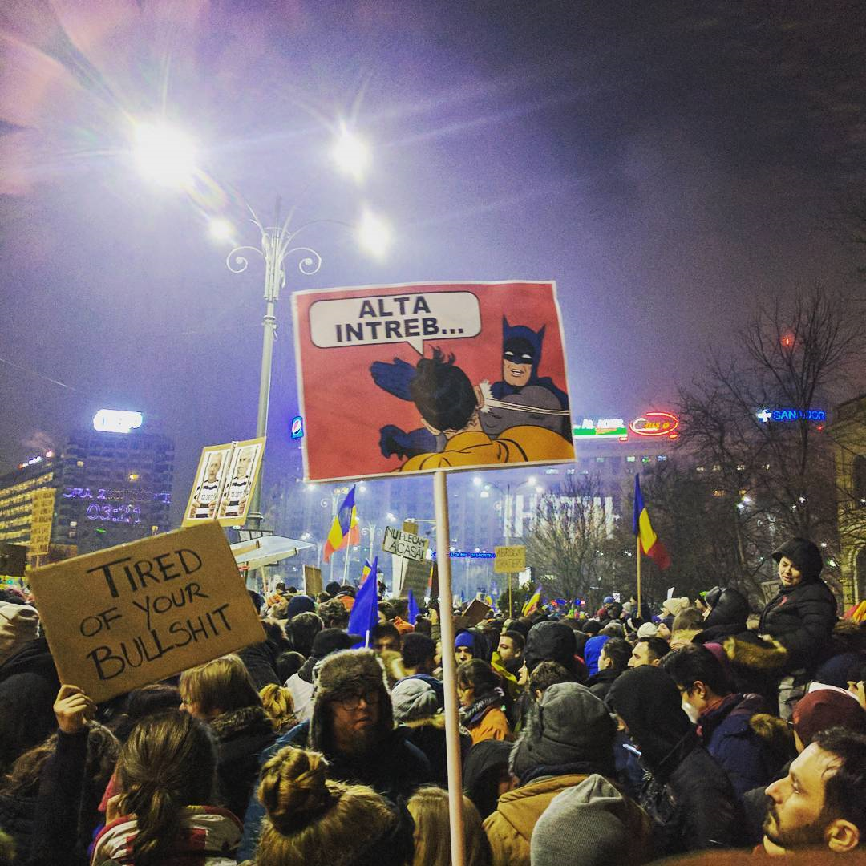
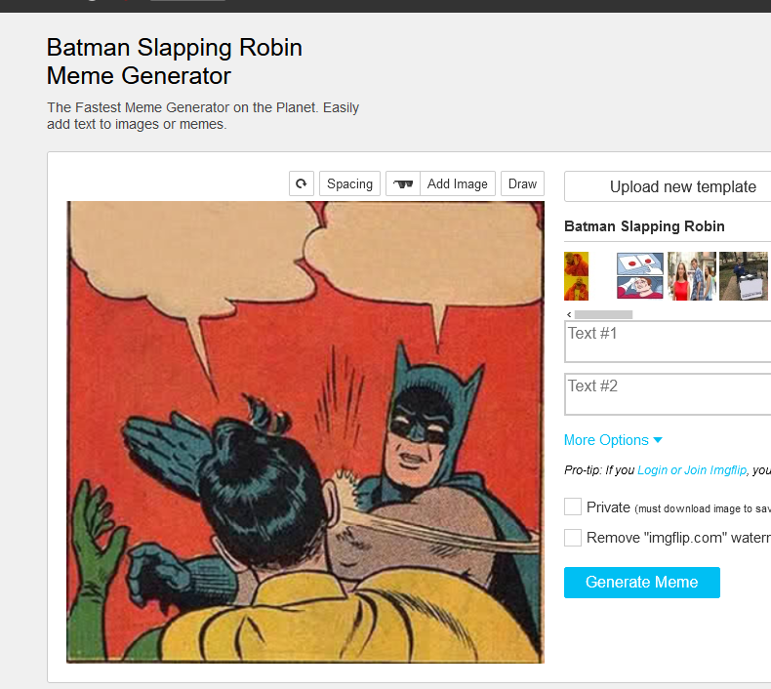

Slide 21
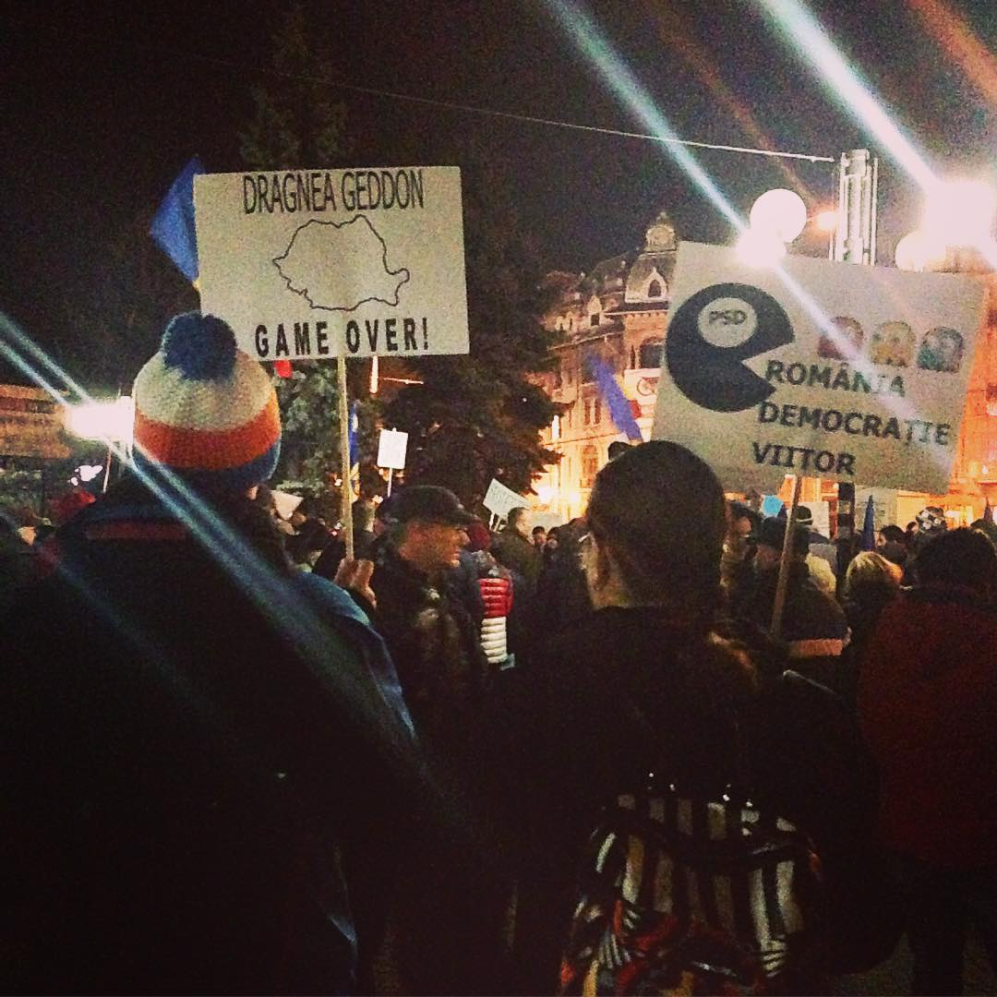

Slide 22
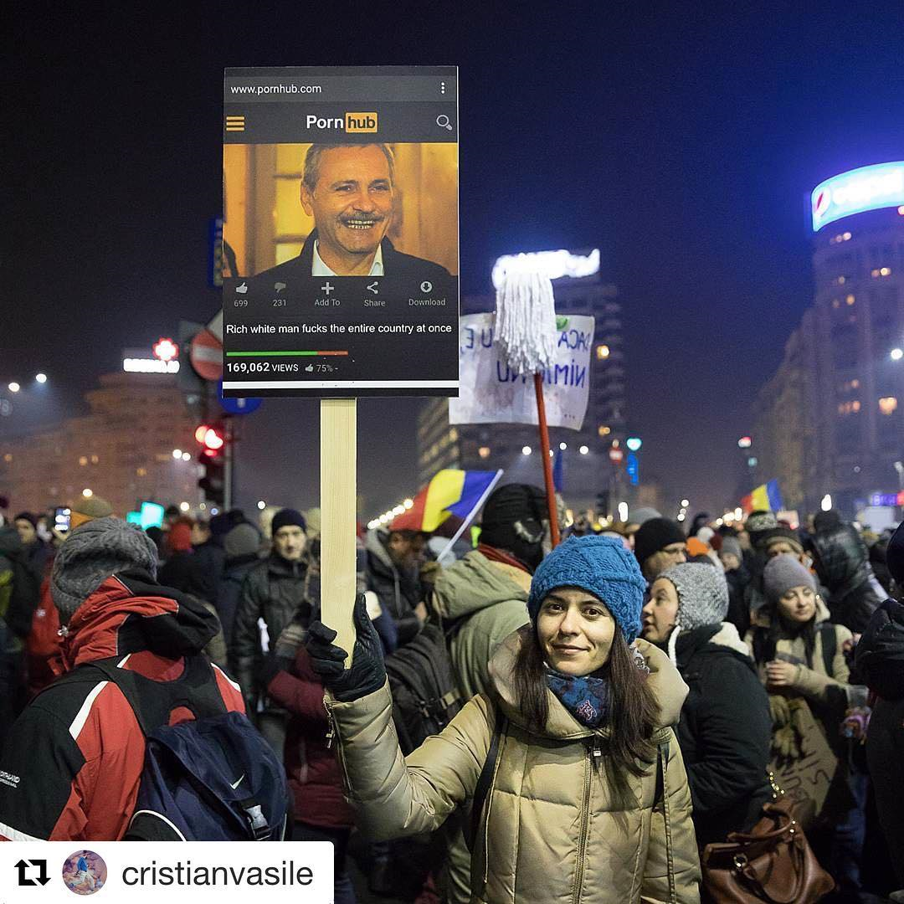

Slide 23
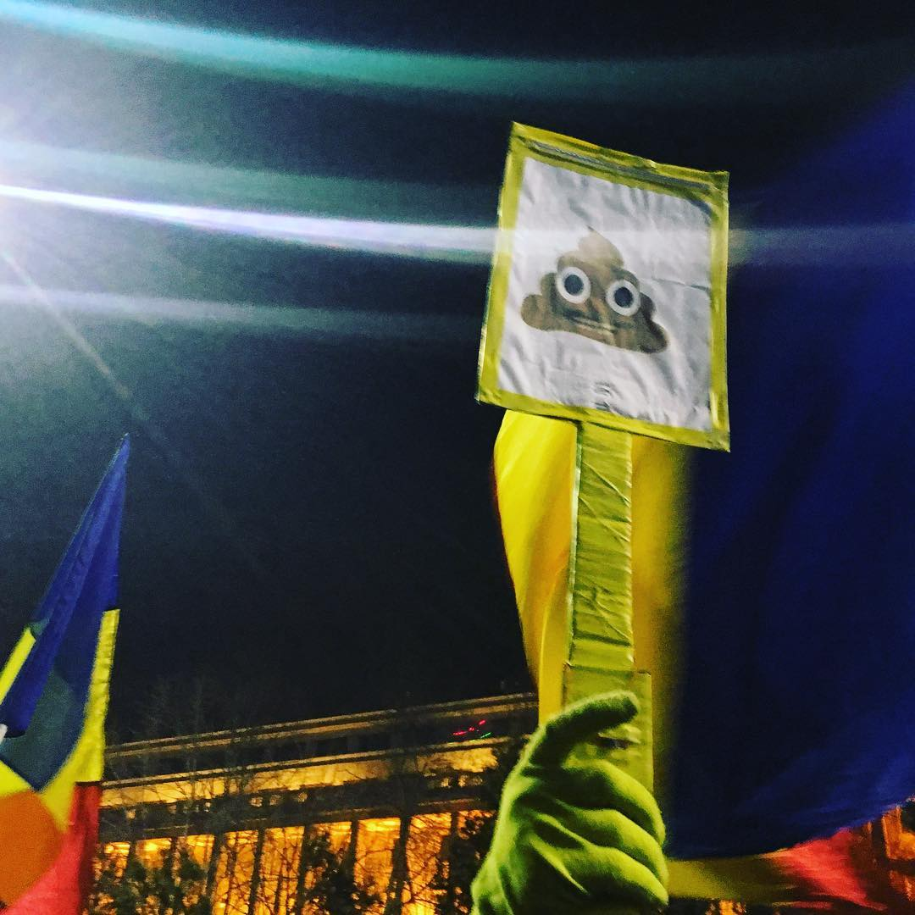

Slide 24
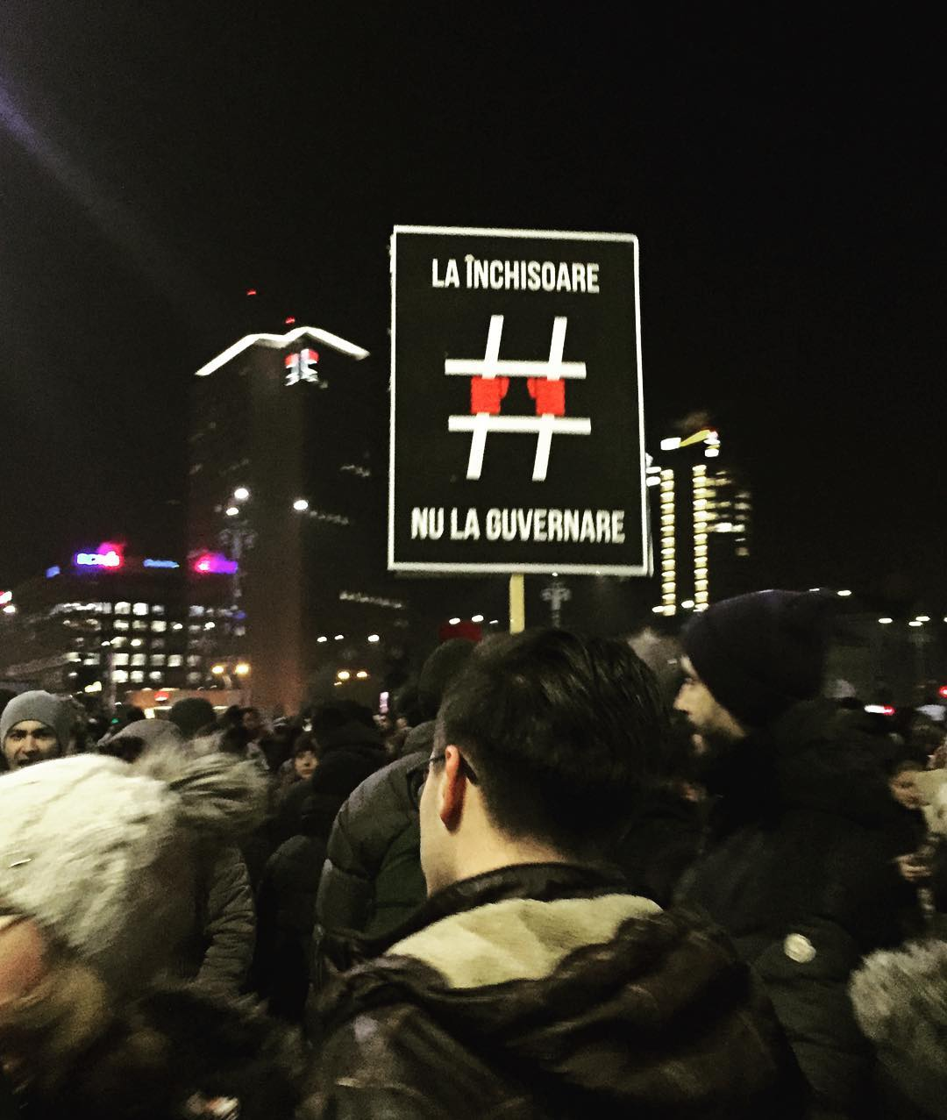

Slide 25
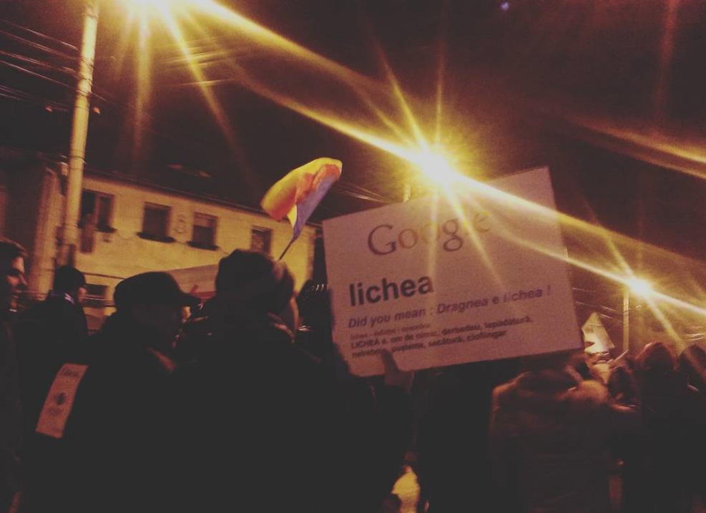
Taken Feb. 4, 2017

Slide 26
References to films

Slide 27
From artofprotest.ro
Waybackmachine
Capture June 26, 2017

Slide 28
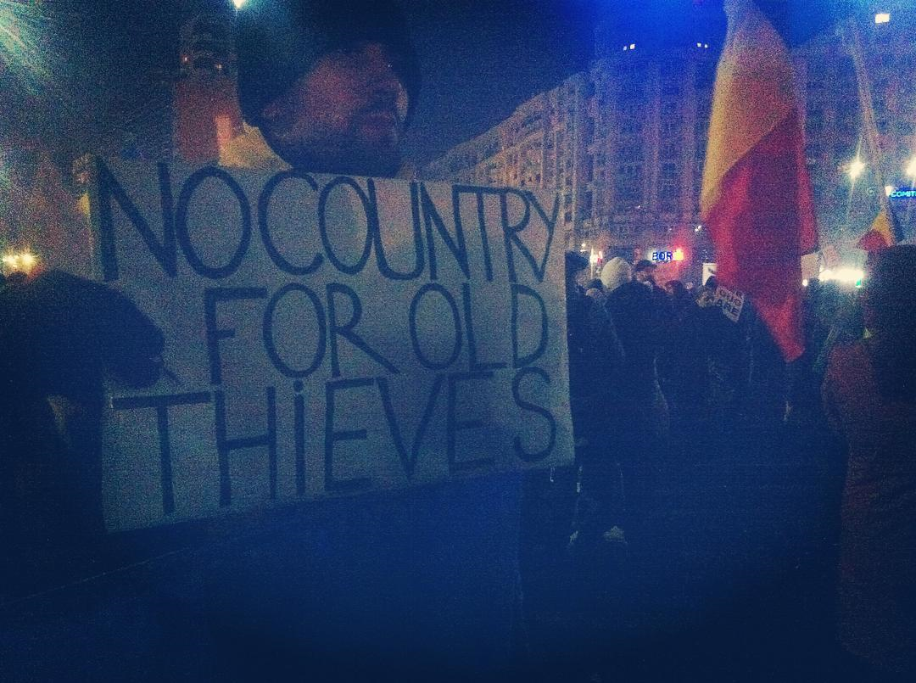

Slide 29
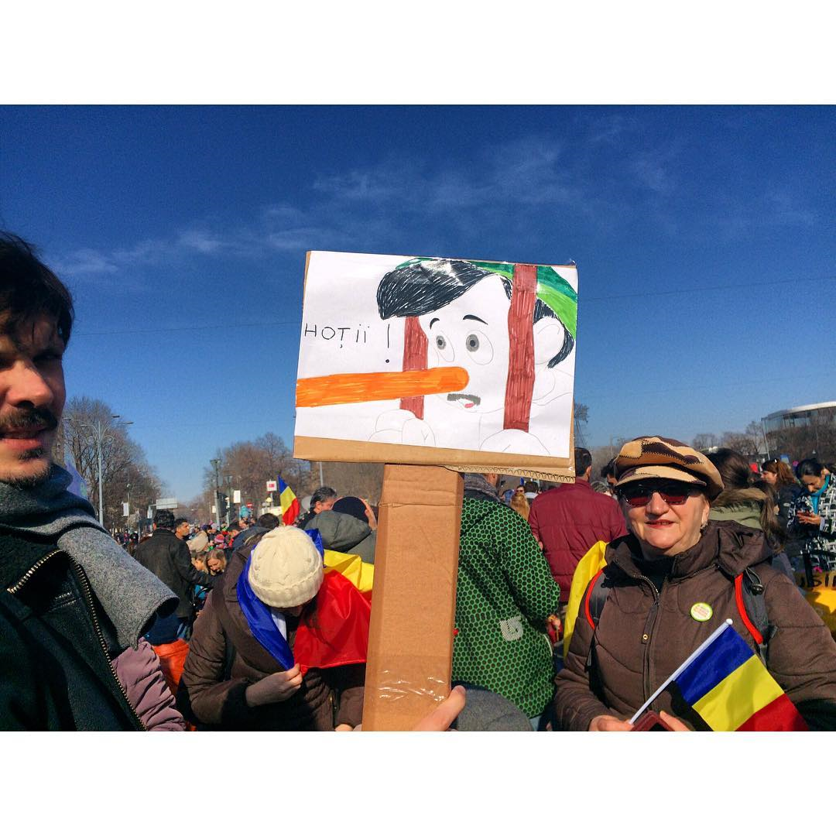

Slide 30
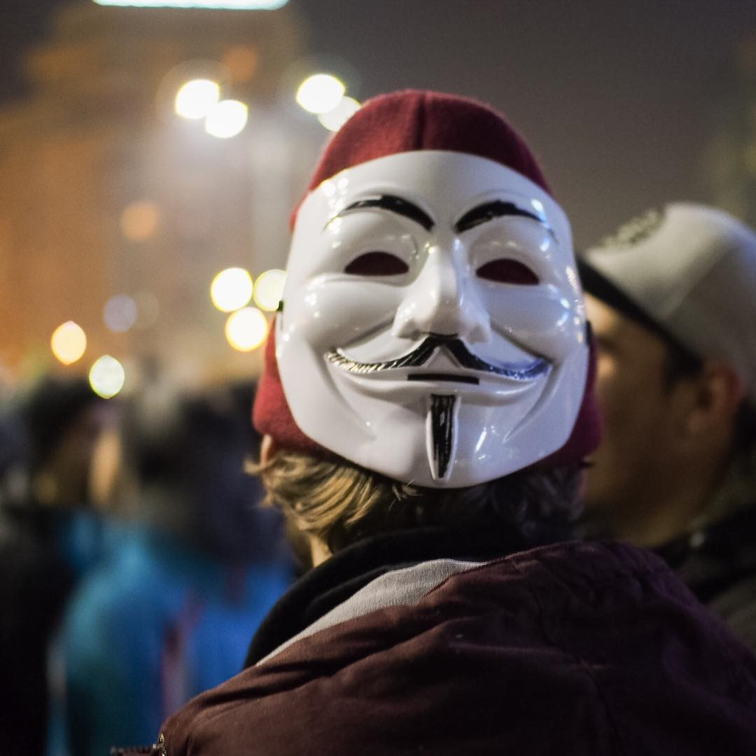
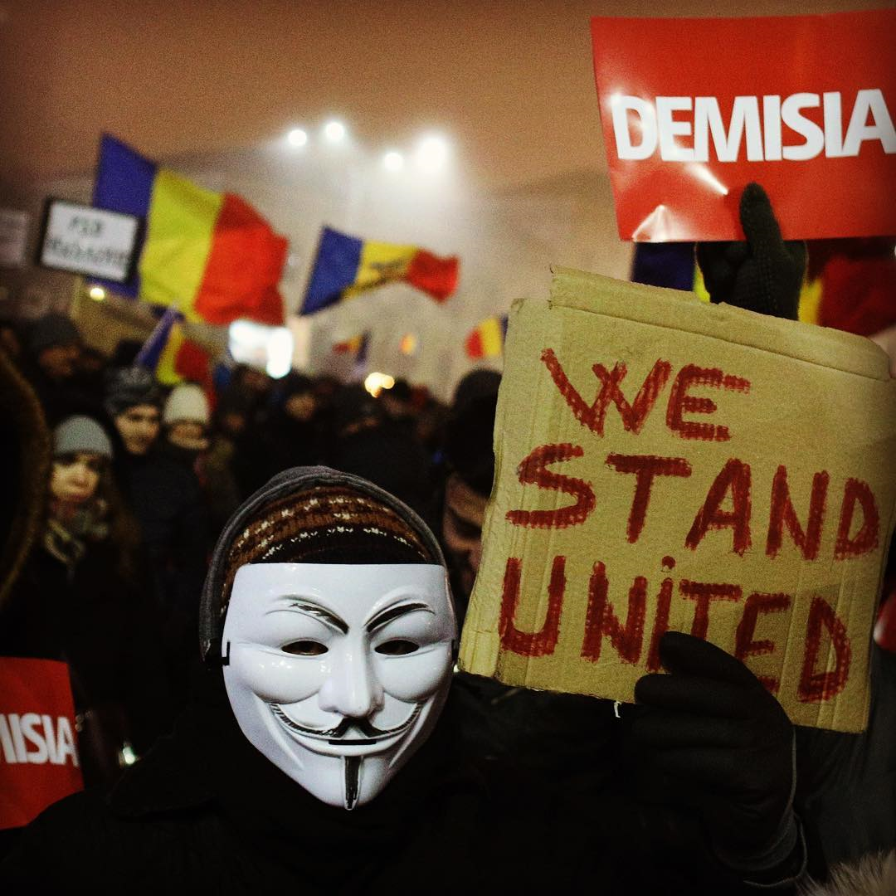

Slide 31
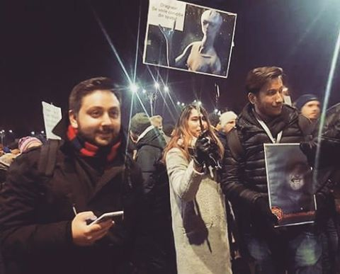

Slide 32
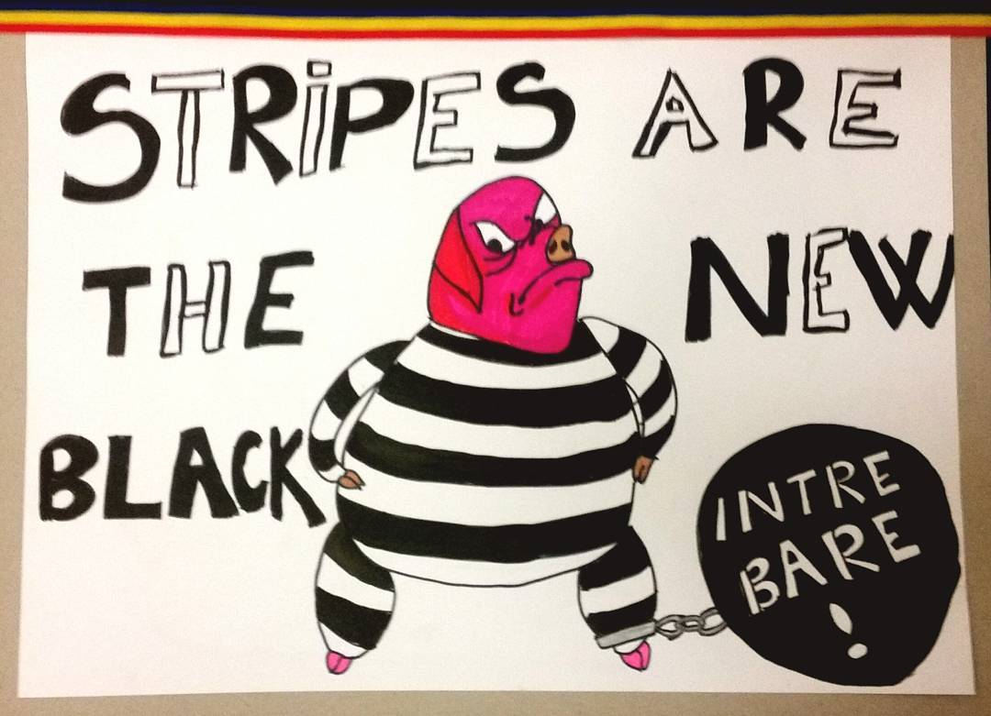

Slide 33
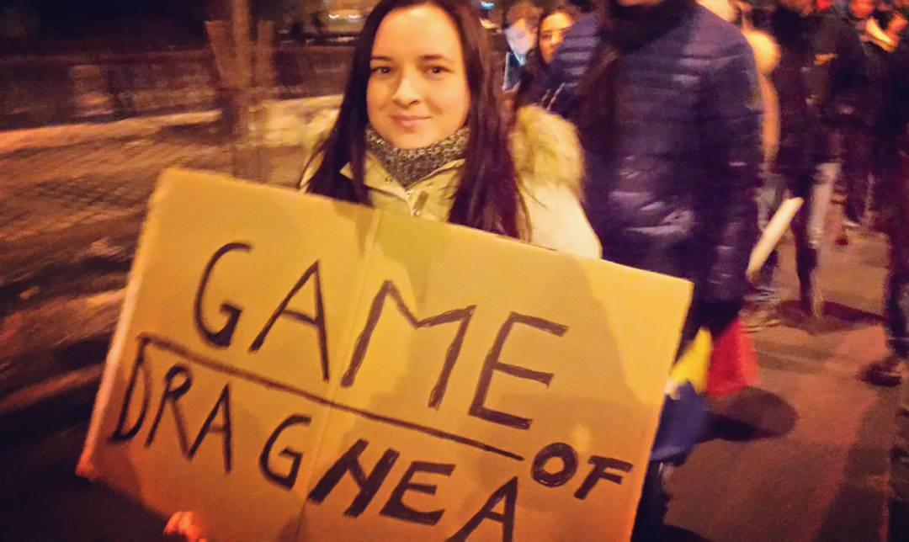

Slide 34
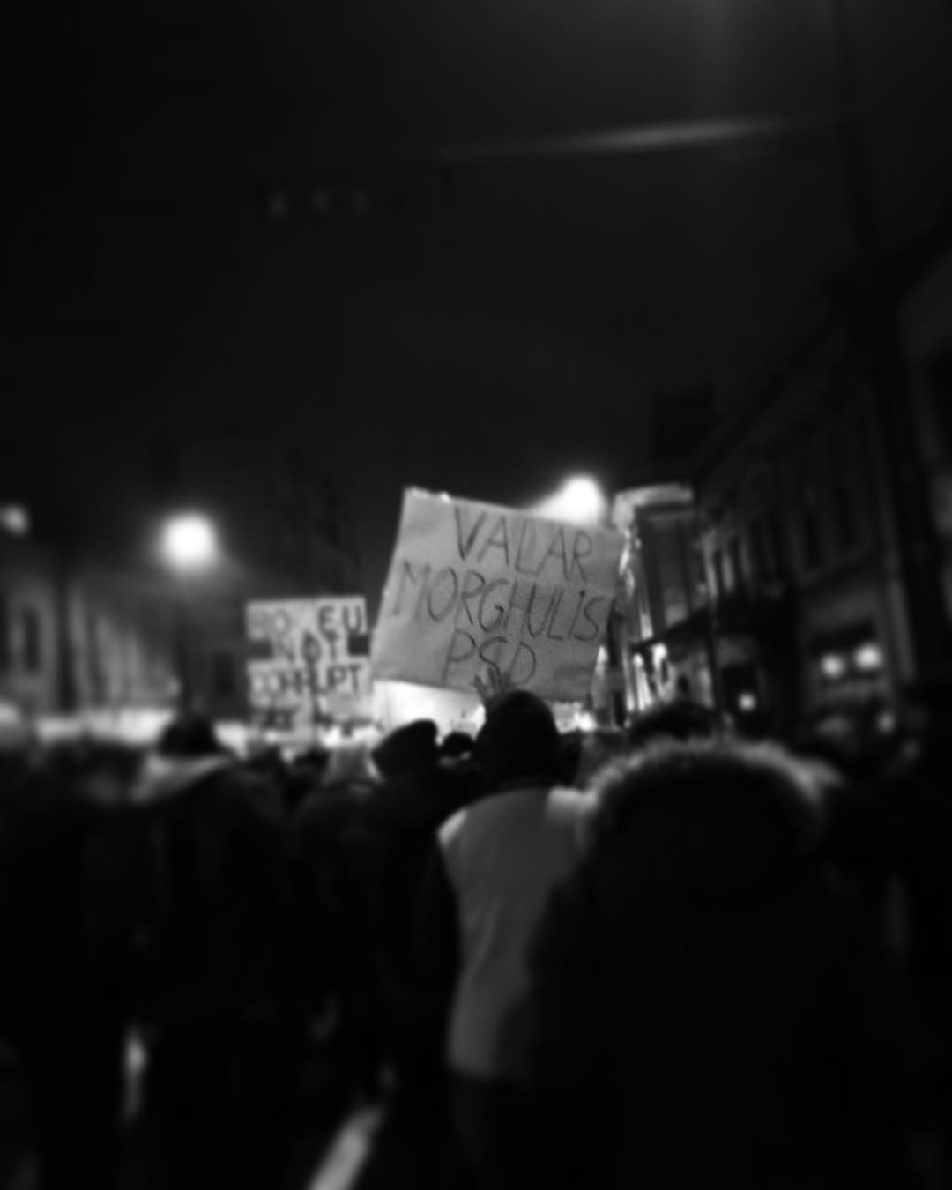
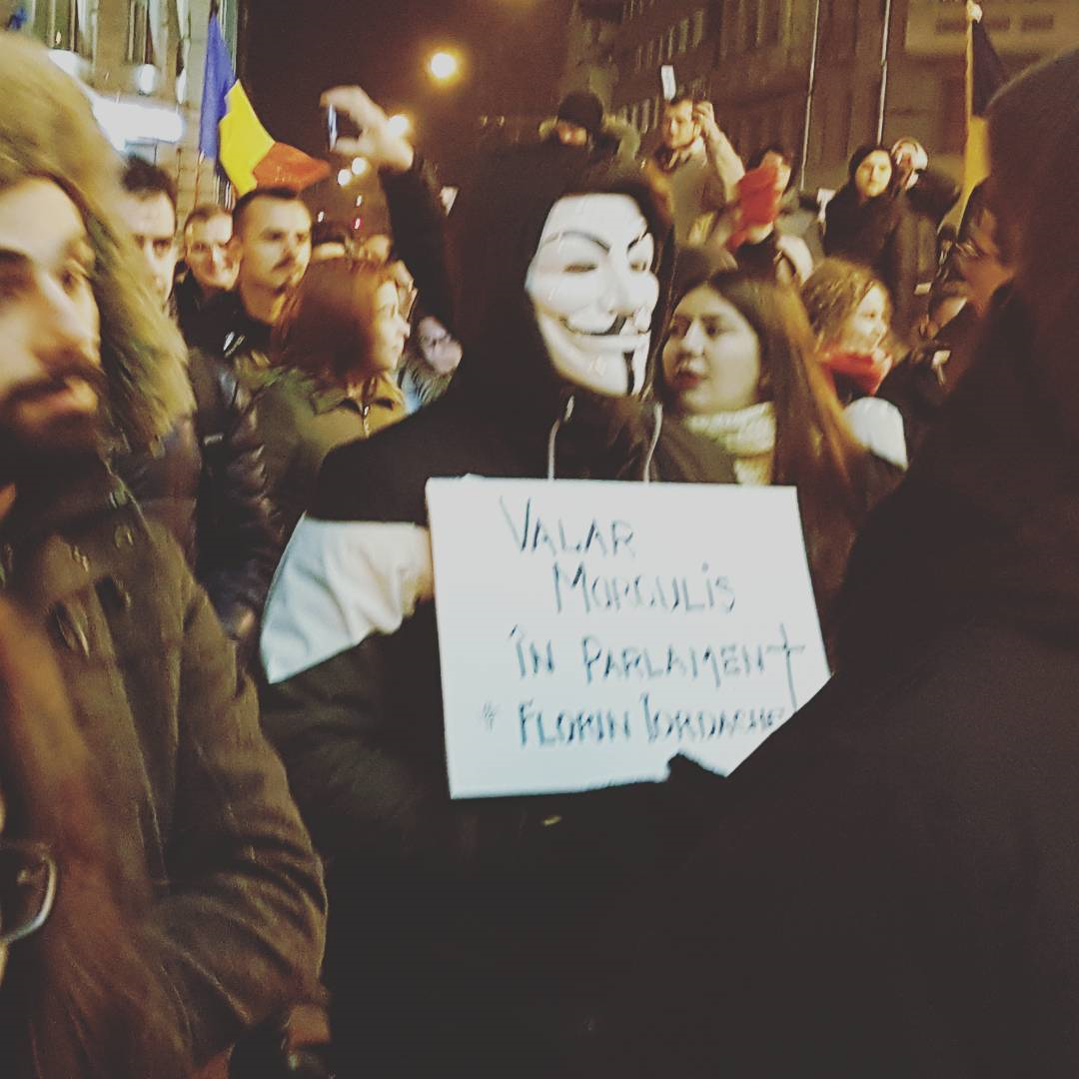

Slide 35
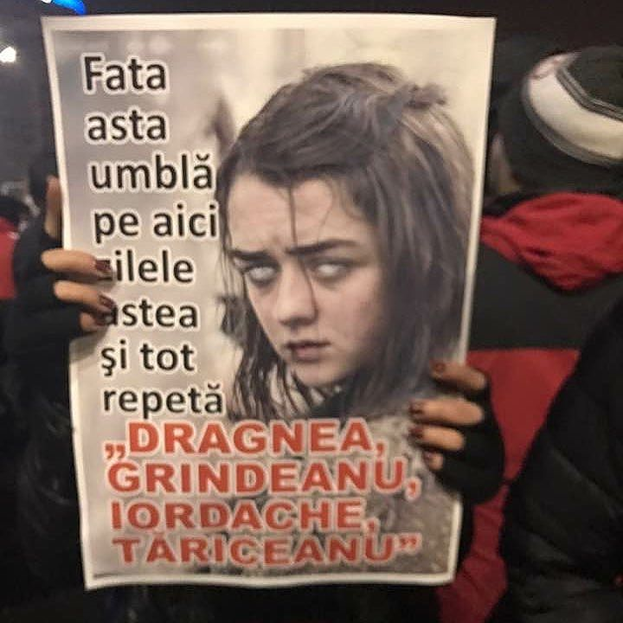

Slide 36
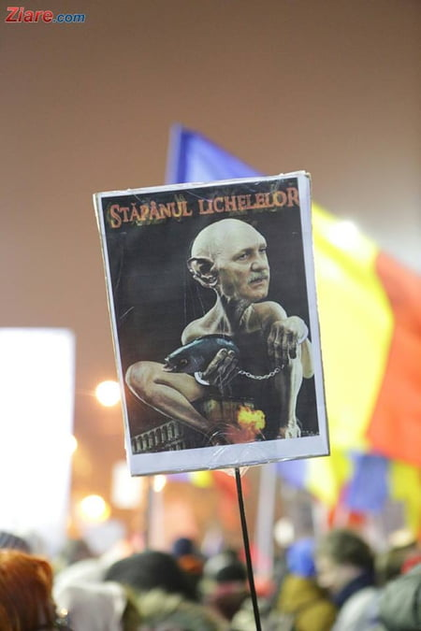
Feb 5, 2017
From Ziare.ro live coverage
http://www.ziare.com/stiri/proteste/live-ziua-celui-mai-mare-protest-studentii-din-cluj-au-ajuns-in-fata-guvernului-1452629

Slide 37
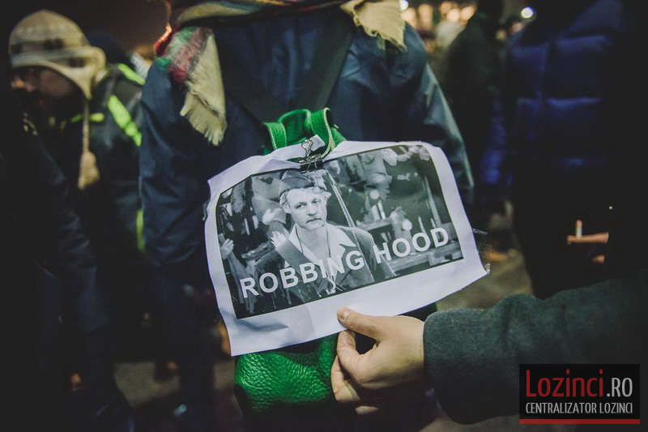
Taken Feb. ?, 2017

Slide 38
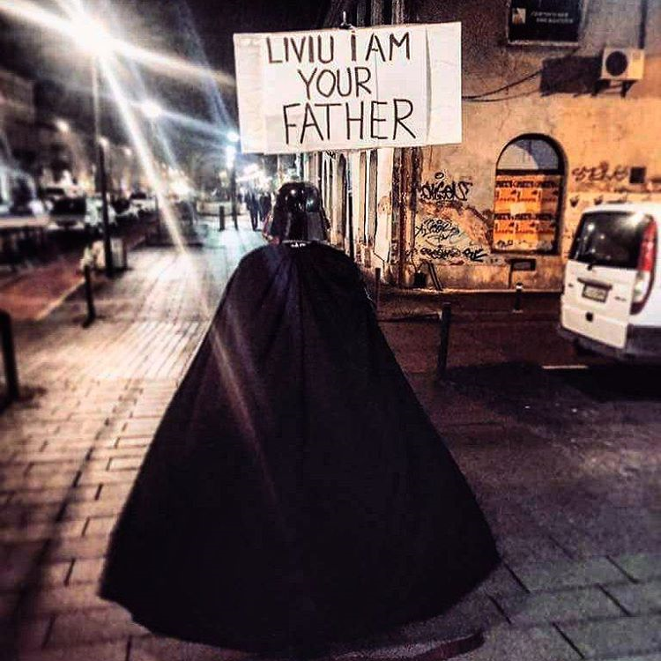

Slide 39
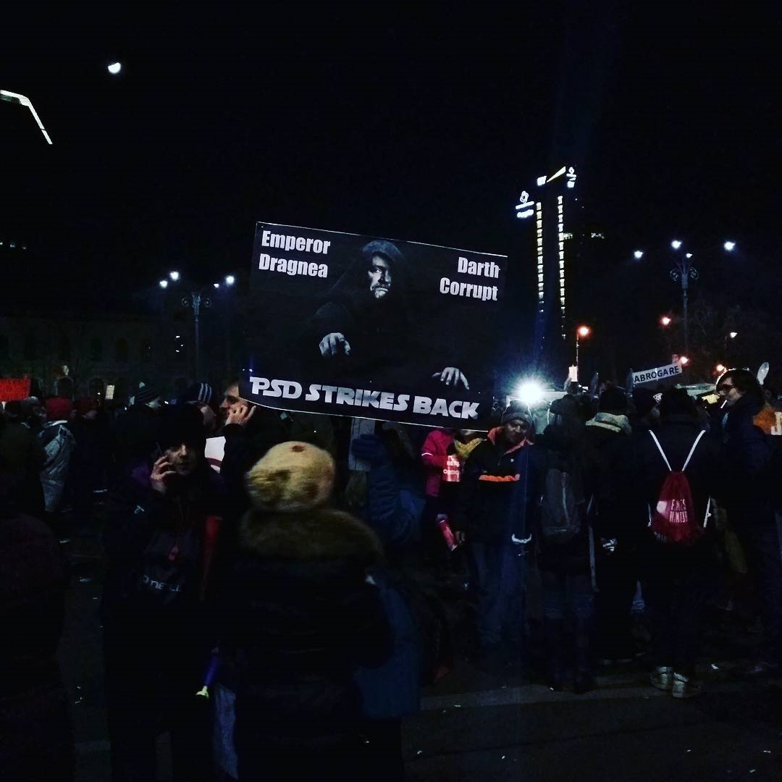

Slide 40
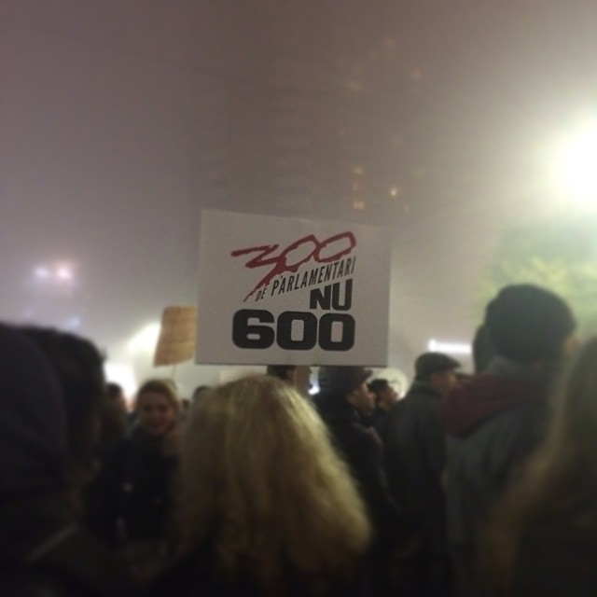

Slide 41
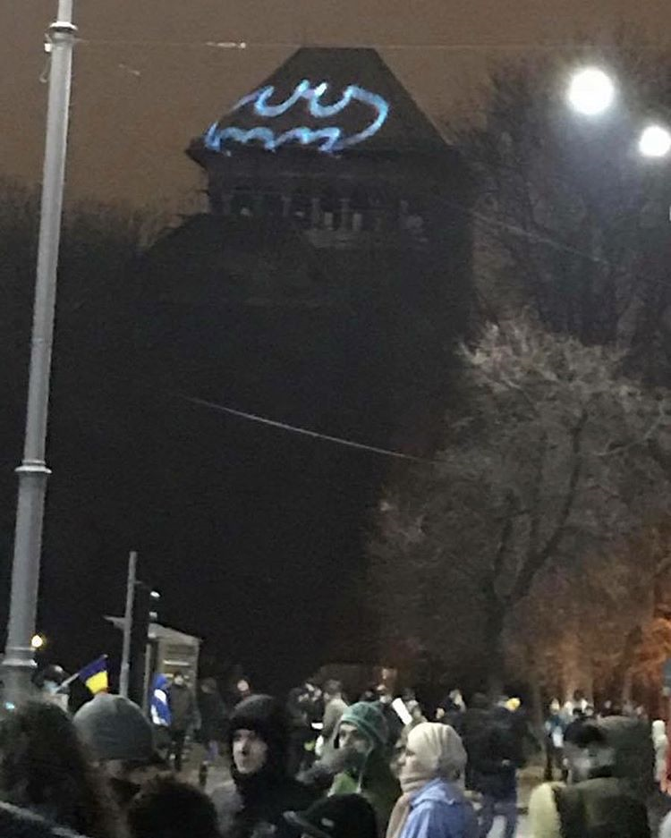

Slide 42
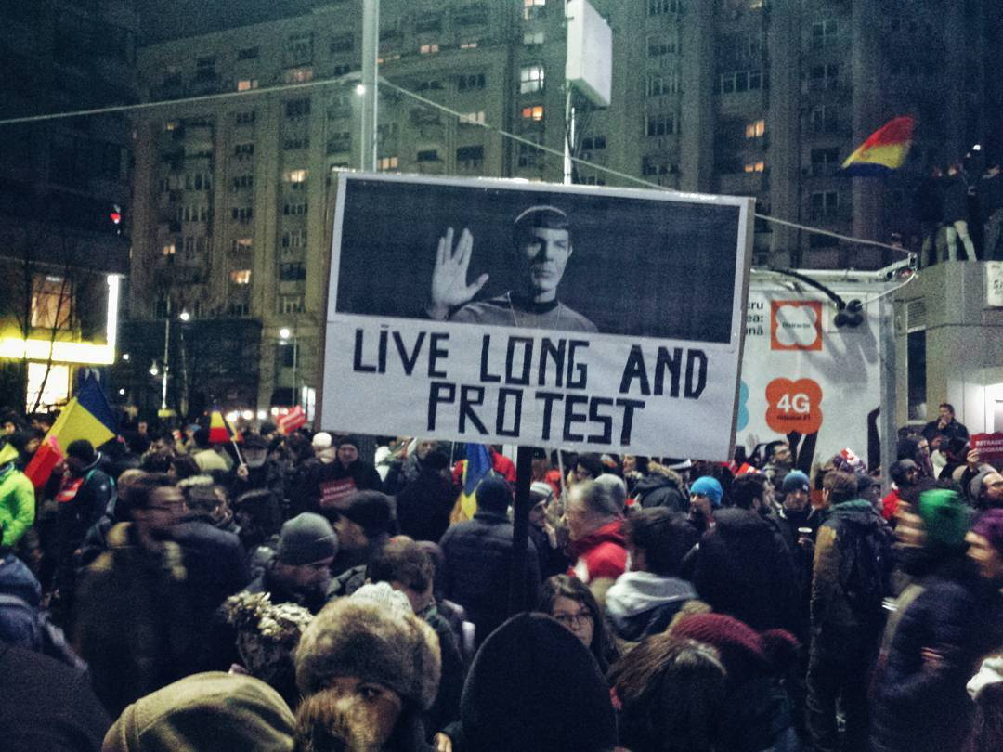

Slide 43
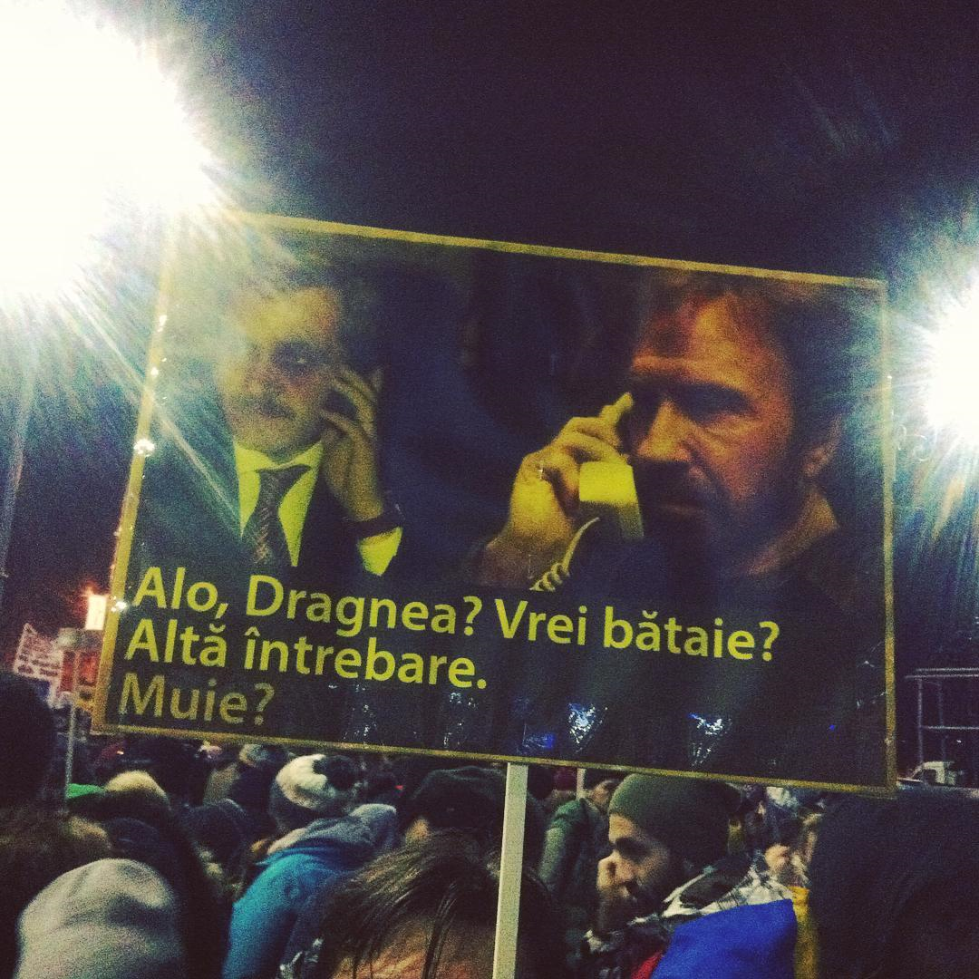

Slide 44
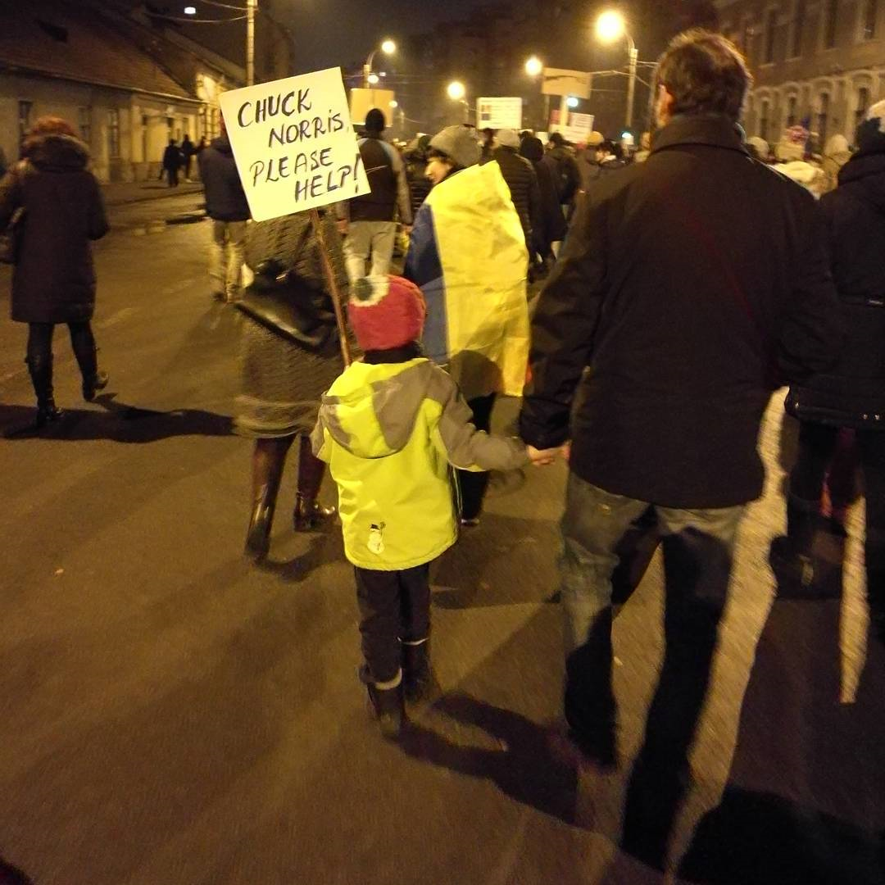

Slide 45
Taken Feb. ?, 2017

Slide 46
Taken Feb. ?, 2017

Slide 47
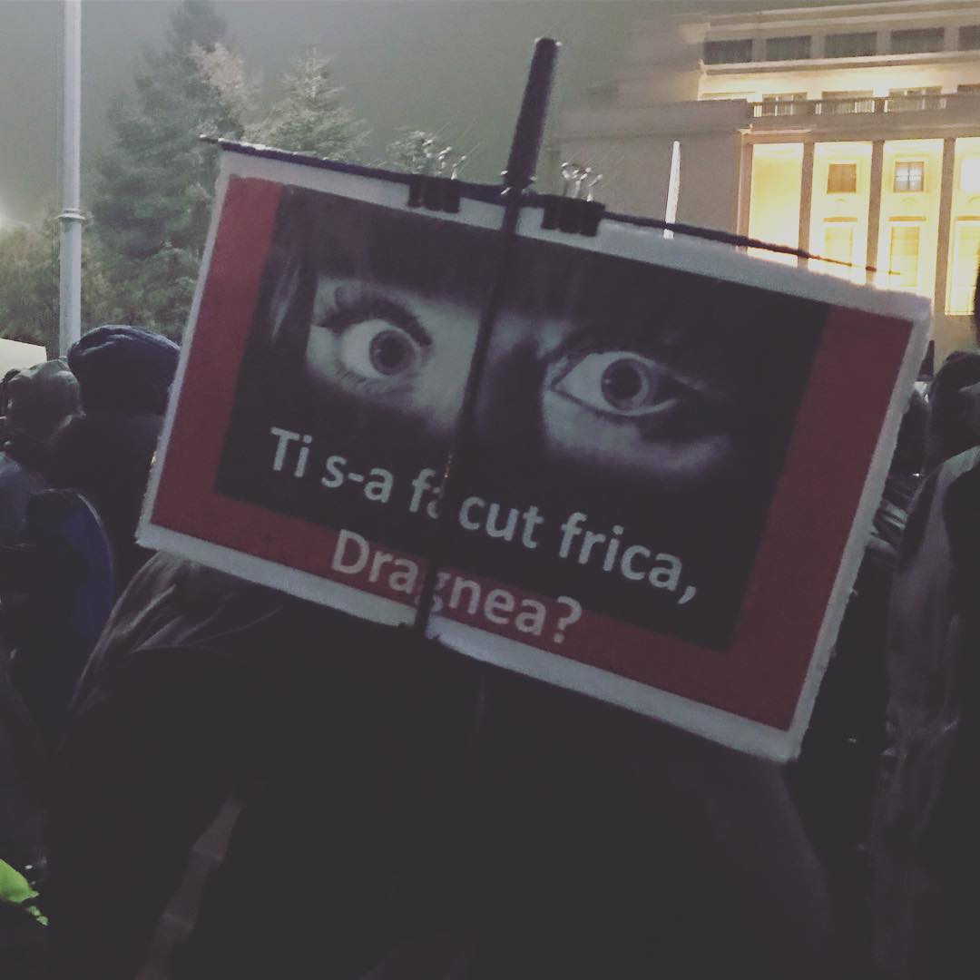

Slide 48
References to books

Slide 49
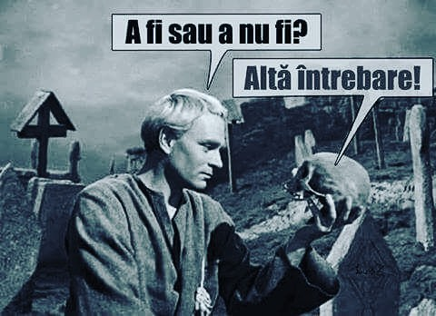
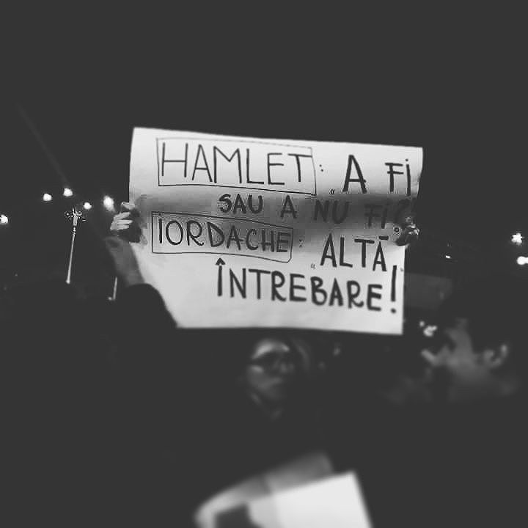

Slide 50
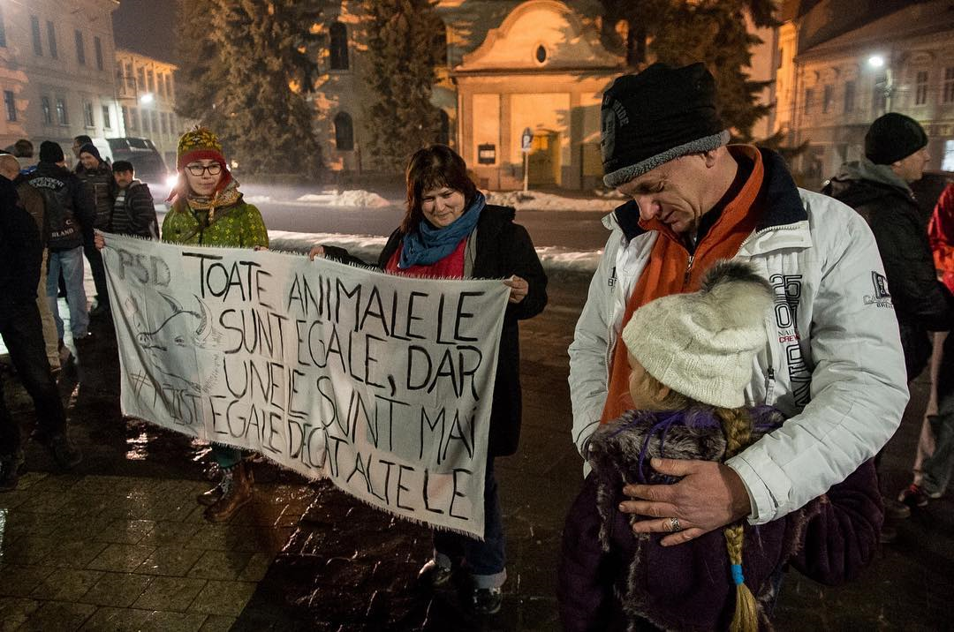

Slide 52
Taken Feb. ?, 2017
Lozinci.ro

Slide 53
References to music

Slide 54
Let go and beg for freedom Another row jumping into the flame Loose lips are shifting leaders From here on out everyone is to blame I'm looking up to my company A full blown artillery Keep the sights on the enemy And bust the lid off anarchy
Your condescending demeanor has all gone wrong Figured you should have known this all along We're not numbers we're free, we're so alive Cause the day we give in is the day we die
Behold, a credo wavering A sleight of hand is the dogma they preach Beneath, a conscience's fading To even out all your steady beliefs Stand your ground in the battle zone Filled with life, bone and scorn Clench your fists, I'm battle prone Pull the trigger and set the tone
Your condescending demeanor has all gone wrong Figured you should have known this all along We're not numbers we're free, we're so alive Cause the day we give in is the day we die
Pull that trigger
Fuck all your wicked corruption It's been there since our inception, but we couldn't see All the times we've felt so hollow As our hopes were hanged in gallows All this time we've been locked away And there was nothing left to say Until today We're not numbers we're free, we're so alive Cause the day we give in is the day we die
https://www.metrolyrics.com/the-day-we-die-lyrics-goodbye-to-gravity.html
Romanian metal band, died in Collectiv.

Slide 56
Paranoia is in bloom The PR transmissions will resume They'll try to push drugs that keep us all dumbed down And hope that we will never see the truth around So come on!
Another promise, another seed Another packaged lie to keep us trapped in greed And all the green belts wrapped around our minds And endless red tape to keep the truth confined So come on!
They will not force us They will stop degrading us They will not control us We will be victorious So come on!
Interchanging mind control Come, let the revolution take its toll If you could flick the switch and open your third eye You'd see that we should never be afraid to die So come on!
Rise up and take the power back It's time the fat cats had a heart attack You know that their time's coming to an end We have to unify and watch our flag ascend So come on!
They will not force us They will stop degrading us They will not control us We will be victorious So come on!
They will not force us They will stop degrading us They will not control us We will be victorious So come on!

Slide 57
References to brands (culture jams)

Slide 63
References to iconic protest signs

Slide 66
https://www.nationalgeographic.com/history/2020/07/history-of-raised-fist-global-symbol-fighting-oppression/
The raised fist has been a staple of protests across the United States as the country continues to grapple with systemic racism.
Now the gesture is firmly embedded in anti-racist protests.

Slide 67
https://nl.pinterest.com/thyra1685/i-cant-believe-im-still-protesting-this-shit/

Slide 72
Taken Feb., 2017

